Slide 1

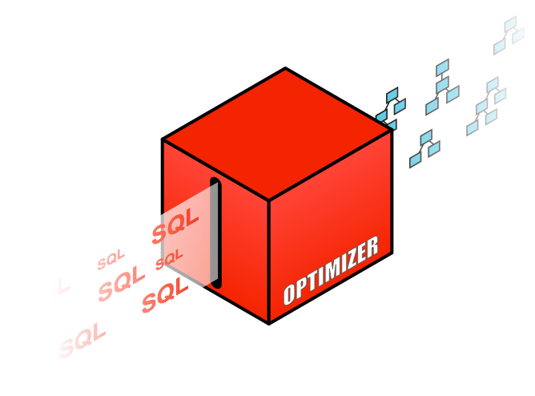
SQL Tuning tips and tricks

Slide 2
Agenda
Using the right tools
Functions, friends or foes?
Data type dilemmas
Optimizer hints
Influencing the execution plan without adding hints

Slide 3
Using the right tools
Expected index range scan but got full table scan?
Query – How many customers do we have in a specific zipcode
Customers2 table has b-tree index on zipcode
There is a histogram on the zipcode column due to data skew
SELECT count(cust_first_name)
FROM customers2
WHERE zipcode = :n;

Slide 4
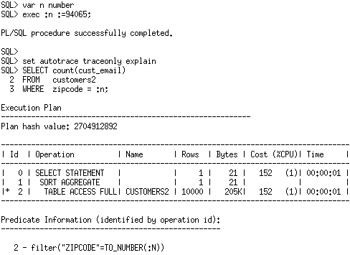
Using the right tools
Set bind variable :n to 94065
Expected index range scan but got full table scan?

Slide 5
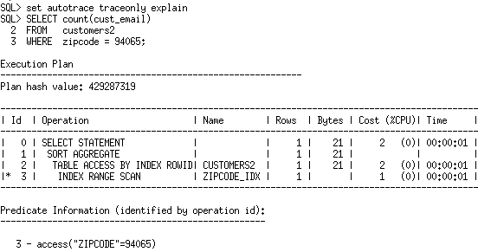
Using the right tools
Using literal value gets the expected plan
Correct plan is achieved when literal value is used
Why is the bind variable version getting the wrong plan?

Slide 6
Using the right tools
Why is there a TO_NUMBER function on the bind variable n after it was defined as a number?
Why is simple equality predicate being applied as filter and no as access?

Slide 7
Using the right tools
Bad plan is actually caused by using autotrace
Autotrace is not aware of bind at all
Hence TO_NUMBER on n
No bind peeking takes place

Slide 8
Using the right tools
Cardinality estimate doesn’t use histogram
Calculated using
ROW_NUM 20,000
NDV 2

Slide 9
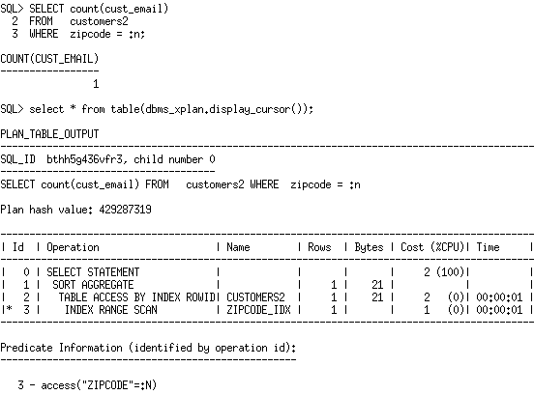
Using the right tools
Solution – use DBMS_XPLAN.DISPLAY_CURSOR
Execute the statement with the bind then run DBMS_XPLAN command

Slide 10
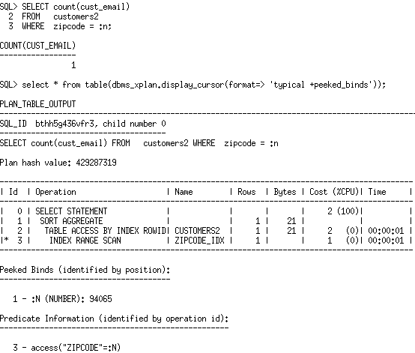
Using the right tools
Additional format option shows actual bind value under the plan

Slide 11
Agenda
Using the right tools
Functions, friends or foes?
Data type dilemmas
Optimizer hints
Influencing the execution plan without adding hints

Slide 12
Function Abuse
Cardinality estimation issues
May reduce access paths
Can increase CPU needs (repeated function calls)
Could lead to partition elimination elimination

Slide 13
Cardinality Estimation Issues
ops$tkyte%ORA11GR2> create table t
2 as
3 select *
4 from all_objects
5 /
Table created.

Slide 14
Cardinality Estimation Issues
ops$tkyte%ORA11GR2> select count(*)
2 from t
3 where created >= to_date( '5-sep-2010', 'dd-mon-yyyy' )
4 and created < to_date( '6-sep-2010', 'dd-mon-yyyy' )
5 /
COUNT(*)
----------
65925
ops$tkyte%ORA11GR2> select count(*), 0.01 * count(*), 0.01 * 0.01 * count(*)
2 from t
3 /
COUNT(*) 0.01*COUNT(*) 0.01*0.01*COUNT(*)
---------- ------------- ------------------
72926 729.26 7.2926

Slide 15
Cardinality Estimation Issues
ops$tkyte%ORA11GR2> exec dbms_stats.gather_table_stats( user, 'T' );
PL/SQL procedure successfully completed.
Why did I wait till here to gather statistics?

Slide 16
Cardinality Estimation Issues
ops$tkyte%ORA11GR2> select count(*)
2 from t t2
3 where created >= to_date( '5-sep-2010', 'dd-mon-yyyy' )
4 and created < to_date( '6-sep-2010', 'dd-mon-yyyy' )
5 /
COUNT(*)
----------
65925
ops$tkyte%ORA11GR2> select * from table(dbms_xplan.display_cursor);
---------------------------------------------------------------------------
| Id | Operation | Name | Rows | Bytes | Cost (%CPU)| Time |
---------------------------------------------------------------------------
| 0 | SELECT STATEMENT | | | | 291 (100)| |
| 1 | SORT AGGREGATE | | 1 | 8 | | |
|* 2 | TABLE ACCESS FULL| T | 65462 | 511K| 291 (1)| 00:00:04 |
---------------------------------------------------------------------------
Predicate Information (identified by operation id):
---------------------------------------------------
2 - filter(("CREATED"<TO_DATE(' 2010-09-06 00:00:00', 'syyyy-mm-dd
hh24:mi:ss') AND "CREATED">=TO_DATE(' 2010-09-05 00:00:00',
'syyyy-mm-dd hh24:mi:ss')))

Slide 17
Cardinality Estimation Issues
ops$tkyte%ORA11GR2> select count(*)
2 from t t1
3 where trunc(created) = to_date( '5-sep-2010', 'dd-mon-yyyy' )
4 /
COUNT(*)
----------
65925
ops$tkyte%ORA11GR2> select * from table(dbms_xplan.display_cursor);
---------------------------------------------------------------------------
| Id | Operation | Name | Rows | Bytes | Cost (%CPU)| Time |
---------------------------------------------------------------------------
| 0 | SELECT STATEMENT | | | | 294 (100)| |
| 1 | SORT AGGREGATE | | 1 | 8 | | |
|* 2 | TABLE ACCESS FULL| T | 729 | 5832 | 294 (2)| 00:00:04 |
---------------------------------------------------------------------------
Predicate Information (identified by operation id):
---------------------------------------------------
2 - filter(TRUNC(INTERNAL_FUNCTION("CREATED"))=TO_DATE(' 2010-09-05
00:00:00', 'syyyy-mm-dd hh24:mi:ss'))

Slide 18
Cardinality Estimation Issues
ops$tkyte%ORA11GR2> select count(*)
2 from t t1
3 where trunc(created) = to_date( '5-sep-2010', 'dd-mon-yyyy' )
4 and substr( owner, 1, 3 ) = 'SYS'
5 /
COUNT(*)
----------
33535
ops$tkyte%ORA11GR2> select * from table(dbms_xplan.display_cursor);
---------------------------------------------------------------------------
| Id | Operation | Name | Rows | Bytes | Cost (%CPU)| Time |
---------------------------------------------------------------------------
| 0 | SELECT STATEMENT | | | | 292 (100)| |
| 1 | SORT AGGREGATE | | 1 | 14 | | |
|* 2 | TABLE ACCESS FULL| T | 7 | 98 | 292 (1)| 00:00:04 |
---------------------------------------------------------------------------
Predicate Information (identified by operation id):
---------------------------------------------------
2 - filter((SUBSTR("OWNER",1,3)='SYS' AND
TRUNC(INTERNAL_FUNCTION("CREATED"))=TO_DATE(' 2010-09-05 00:00:00'
'syyyy-mm-dd hh24:mi:ss')))

Slide 19
Cardinality Estimation Issues
ops$tkyte%ORA11GR2> select count(*)
2 from t t1
3 where trunc(created) = to_date( '5-sep-2010', 'dd-mon-yyyy' )
4 and substr( owner, 1, 3 ) = 'SYS'
5 and mod(object_id,100000) > 1
6 /
COUNT(*)
----------
33535
ops$tkyte%ORA11GR2> select * from table(dbms_xplan.display_cursor);
---------------------------------------------------------------------------
| Id | Operation | Name | Rows | Bytes | Cost (%CPU)| Time |
---------------------------------------------------------------------------
| 0 | SELECT STATEMENT | | | | 292 (100)| |
| 1 | SORT AGGREGATE | | 1 | 19 | | |
|* 2 | TABLE ACCESS FULL| T | 1 | 19 | 292 (1)| 00:00:04 |
---------------------------------------------------------------------------
Predicate Information (identified by operation id):
---------------------------------------------------
2 - filter((SUBSTR("OWNER",1,3)='SYS' AND MOD("OBJECT_ID",100000)>1
AND TRUNC(INTERNAL_FUNCTION("CREATED"))=TO_DATE(' 2010-09-05 00:00
'syyyy-mm-dd hh24:mi:ss')))

Slide 20
Compile with warnings…
SQL> alter session set plsql_warnings='enable:all’;
SQL> create or replace procedure p
2 as
3 begin
4 dbms_output.put_line( 'hello world' );
5 exception
6 when others
7 then null;
8 end;
9 /
Warning: Procedure created with compilation errors.
c##tkyte%CDB1> show errors
Errors for PROCEDURE P:
LINE/COL ERROR
---- -----------------------------------------------------------------
6/6 PLS-06009: procedure "P" OTHERS handler does not end in RAISE or
RAISE_APPLICATION_ERROR

Slide 21
Increased CPU
ops$tkyte%ORA11GR2> create or replace procedure p authid definer
2 as
3 l_date varchar2(30) := '01-jan-2011';
4 l_start number := dbms_utility.get_cpu_time;
5 begin
6 for i in 1 .. 10
7 loop
8 for x in ( select owner, object_name
9 from big_table.big_table
10 where created = l_date )
11 loop
12 null;
13 end loop;
14 end loop;
15 dbms_output.put_line( 'CPU: ' ||
16 to_char( dbms_utility.get_cpu_time-l_start ) );
17 end;
18 /
SP2-0804: Procedure created with compilation warnings
ops$tkyte%ORA11GR2> exec p
CPU: 132
Notes:
21

Slide 22
Increased CPU
…
7 loop
8 for x in ( select owner, object_name
9 from big_table.big_table
10 where created = l_date )
11 loop
12 null;
13 end loop;
…
ops$tkyte%ORA11GR2> show errors procedure p
Errors for PROCEDURE P:
LINE/COL ERROR
-------- -----------------------------------------------------------------
10/36 PLW-07204: conversion away from column type may result in
sub-optimal query plan
Notes:
22

Slide 23
Increased CPU
ops$tkyte%ORA11GR2> create or replace procedure p authid definer
2 as
3 l_date date := to_date('01-jan-2011','dd-mon-yyyy');
4 l_start number := dbms_utility.get_cpu_time;
5 begin
6 for i in 1 .. 10
7 loop
8 for x in ( select owner, object_name
9 from big_table.big_table
10 where created = l_date )
11 loop
12 null;
13 end loop;
14 end loop;
15 dbms_output.put_line( 'CPU: ' ||
16 to_char( dbms_utility.get_cpu_time-l_start ) );
17 end;
18 /
Procedure created.
ops$tkyte%ORA11GR2> exec p
CPU: 94 30% less CPU in this case
Notes:
23

Slide 24
Reduced Access Paths
ops$tkyte%ORA11GR2> create table t
2 ( x varchar2(20) constraint t_pk primary key,
3 y varchar2(30)
4 );
Table created.
ops$tkyte%ORA11GR2> insert into t
2 select user_id, username
3 from all_users;
47 rows created.
ops$tkyte%ORA11GR2> commit;
Commit complete.
Notes:
24

Slide 25
Reduced Access Paths
ops$tkyte%ORA11GR2> create or replace procedure p authid definer
2 as
3 l_rec t%rowtype;
4 l_key number := 5;
5 begin
6 select * into l_rec from t where x = l_key;
7 for x in (select plan_table_output
8 from TABLE( dbms_xplan.display_cursor()))
9 loop
10 dbms_output.put_line( x.plan_table_output );
11 end loop;
12 end;
13 /
SP2-0804: Procedure created with compilation warnings
Notes:
25

Slide 26
Reduced Access Paths
…
5 begin
6 select * into l_rec from t where x = l_key;
7 for x in (select plan_table_output
…
ops$tkyte%ORA11GR2> show errors
Errors for PROCEDURE P:
LINE/COL ERROR
-------- -----------------------------------------------------------
6/42 PLW-07204: conversion away from column type may result in
sub-optimal query plan
Notes:
26

Slide 27
Reduced Access Paths
ops$tkyte%ORA11GR2> exec p
SQL_ID 18796jgha0hwz, child number 0
-------------------------------------
SELECT * FROM T WHERE X = :B1
Plan hash value: 1601196873
--------------------------------------------------------------------------
| Id | Operation | Name | Rows | Bytes | Cost (%CPU)| Time |
--------------------------------------------------------------------------
| 0 | SELECT STATEMENT | | | | 3 (100)| |
|* 1 | TABLE ACCESS FULL| T | 1 | 29 | 3 (0)| 00:00:01 |
--------------------------------------------------------------------------
Predicate Information (identified by operation id):
---------------------------------------------------
1 - filter(TO_NUMBER("X")=:B1)
Notes:
27

Slide 28
Reduced Access Paths
ops$tkyte%ORA11GR2> create or replace procedure p authid definer
2 as
3 l_rec t%rowtype;
4 l_key varchar2(5) := '5';
5 begin
6 select * into l_rec from t where x = l_key;
7 for x in (select plan_table_output
8 from TABLE( dbms_xplan.display_cursor()))
9 loop
10 dbms_output.put_line( x.plan_table_output );
11 end loop;
12 end;
13 /
Procedure created.
ops$tkyte%ORA11GR2> show errors
No errors.
Notes:
28

Slide 29
Reduced Access Paths
ops$tkyte%ORA11GR2> exec p
SQL_ID 18796jgha0hwz, child number 1
-------------------------------------
SELECT * FROM T WHERE X = :B1
Plan hash value: 1303508680
------------------------------------------------------------------------------------
| Id | Operation | Name | Rows | Bytes | Cost (%CPU)| Time |
------------------------------------------------------------------------------------
| 0 | SELECT STATEMENT | | | | 1 (100)| |
| 1 | TABLE ACCESS BY INDEX ROWID| T | 1 | 29 | 1 (0)| 00:00:01 |
|* 2 | INDEX UNIQUE SCAN | T_PK | 1 | | 1 (0)| 00:00:01 |
------------------------------------------------------------------------------------
Predicate Information (identified by operation id):
---------------------------------------------------
2 - access("X"=:B1)
Notes:
29

Slide 30
Partition Elimination Eliminated
ops$tkyte%ORA11GR2> CREATE TABLE t
2 (
3 dt date,
4 x int,
5 y varchar2(30)
6 )
7 PARTITION BY RANGE (dt)
8 (
9 PARTITION part1 VALUES LESS THAN(to_date('31-jan-2011', 'dd-mon-yyyy')),
10 PARTITION part2 VALUES LESS THAN(to_date('28-feb-2011', 'dd-mon-yyyy'))
11 )
12 /
Table created.
Notes:
30

Slide 31
Partition Elimination Eliminated
ops$tkyte%ORA11GR2> create or replace procedure p authid definer
2 as
3 l_date timestamp := timestamp'2011-01-15 00:00:00.000';
4 l_count number;
5 begin
6 select count(*) into l_count from t where dt = l_date;
7
8 for x in (select plan_table_output
9 from TABLE( dbms_xplan.display_cursor() ) )
10 loop
11 dbms_output.put_line( '.'||x.plan_table_output );
12 end loop;
13 end;
14 /
SP2-0804: Procedure created with compilation warnings
Notes:
31

Slide 32
Partition Elimination Eliminated
…
5 begin
6 select count(*) into l_count from t where dt = l_date;
7
…
SP2-0804: Procedure created with compilation warnings
ops$tkyte%ORA11GR2> show errors
Errors for PROCEDURE P:
LINE/COL ERROR
-------- --------------------------------------------------------------
6/47 PLW-07204: conversion away from column type may result in
sub-optimal query plan
Notes:
32

Slide 33
Partition Elimination Eliminated
SQL_ID 0t5m83d3m67q7, child number 0
-------------------------------------
SELECT COUNT(*) FROM T WHERE DT = :B1
Plan hash value: 3225603066
---------------------------------------------------------------------------------------------
| Id | Operation | Name | Rows | Bytes | Cost (%CPU)| Time | Pstart| Pstop |
---------------------------------------------------------------------------------------------
| 0 | SELECT STATEMENT | | | | 2 (100)| | | |
| 1 | SORT AGGREGATE | | 1 | 9 | | | | |
| 2 | PARTITION RANGE ALL| | 1 | 9 | 2 (0)| 00:00:01 | 1 | 2 |
|* 3 | TABLE ACCESS FULL | T | 1 | 9 | 2 (0)| 00:00:01 | 1 | 2 |
---------------------------------------------------------------------------------------------
Predicate Information (identified by operation id):
---------------------------------------------------
3 - filter(INTERNAL_FUNCTION("DT")=:B1)
Notes:
33

Slide 34
Partition Elimination Eliminated
ops$tkyte%ORA11GR2> create or replace procedure p authid definer
2 as
3 l_date date := to_date( '2011-01-15', 'yyyy-mm-dd' );
4 l_count number;
5 begin
6 select count(*) into l_count from t where dt = l_date;
7
8 for x in (select plan_table_output
9 from TABLE( dbms_xplan.display_cursor() ) )
10 loop
11 dbms_output.put_line( '.'||x.plan_table_output );
12 end loop;
13 end;
14 /
Procedure created.
ops$tkyte%ORA11GR2> show errors
No errors.
Notes:
34

Slide 35
Partition Elimination Eliminated
.SQL_ID 0t5m83d3m67q7, child number 1
.-------------------------------------
.SELECT COUNT(*) FROM T WHERE DT = :B1
.
.Plan hash value: 3660200434
.
.------------------------------------------------------------------------------------------------
.| Id | Operation | Name | Rows | Bytes | Cost (%CPU)| Time | Pstart| Pstop |
.------------------------------------------------------------------------------------------------
.| 0 | SELECT STATEMENT | | | | 2 (100)| | | |
.| 1 | SORT AGGREGATE | | 1 | 9 | | | | |
.| 2 | PARTITION RANGE SINGLE| | 1 | 9 | 2 (0)| 00:00:01 | KEY | KEY |
.|* 3 | TABLE ACCESS FULL | T | 1 | 9 | 2 (0)| 00:00:01 | KEY | KEY |
.------------------------------------------------------------------------------------------------
.
.Predicate Information (identified by operation id):
.---------------------------------------------------
.
. 3 - filter("DT"=:B1)
Notes:
35

Slide 36
Partition Elimination Eliminated
ops$tkyte%ORA11GR2> alter session set Plsql_Warnings = 'error:all‘;
ops$tkyte%ORA11GR2> create or replace procedure p authid definer
2 as
3 l_date timestamp := timestamp'2011-01-15 00:00:00.000';
4 l_count number;
5 begin
6 select count(*) into l_count from t where dt = l_date;
7
8 for x in (select plan_table_output
9 from TABLE( dbms_xplan.display_cursor() ) )
10 loop
11 dbms_output.put_line( '.'||x.plan_table_output );
12 end loop;
13 end;
14 /
Notes:
36

Slide 37
Agenda
Using the right tools
Functions, friends or foes?
Data type dilemmas
Optimizer hints
  What are Optimizer hints
  How do you determine which hint is needs
  Why hint are not obeyed
Influencing the execution plan without adding hints

Slide 38

Optimizer hints
Expectations
This material will not instantly make you an Optimizer hint expert!
Adding hints won’t magically improve every query you encounter
Optimizer hints should only be used with extreme care

Slide 39
What are hints?
Overview
Hints allow you to influence the Optimizer when it has to choose between several possibilities
A hint is a directive that will be followed when applicable
Can influence everything from the Optimizer mode used to each operation in the execution
Automatically means the Cost Based Optimizer will be used
  Only exception is the RULE hint but it must be used alone

Slide 40
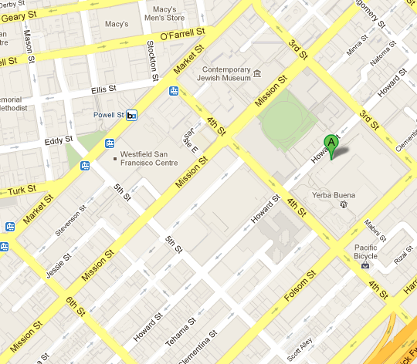
What are hints?
Example - directions to the mall

Slide 41
What are hints?
Example - directions to the mall but don’t take 6th St

Slide 42
What are hints?
Example - directions to the mall if you have insider information

Slide 43
What are hints?
Hints only evaluated when they apply to a decision that has to be made
Should I walk or drive to the mall?
  Best plan would be to walk
Should I go up 4th, 5th, or 6th street?
  Best plan would be to go up 4th street
Should I go in the front or the back door of the mall?
  Best plan would be to go in the back door
Telling me the cheapest parking is at 5th and Mission garage is irrelevant since I decided to walk

Slide 44
Two different classes of hints
Hint mechanism is not exclusively used by the Optimizer
Two types of hints
Non-Optimizer hints
Optimizer hints
  HINTS
Non-Optimizer Hints
Optimizer Hints

Slide 45
Not all hints influence the Optimizer
Overview
The hint mechanism is not exclusively used by the Optimizer
Several other functional area use hints too
  Direct path load can be controlled by APPEND hint
  Parallel statement queuing can be controlled by STATEMENT_QUEUING hint
  Data management in buffer cache can be influenced by CACHE hint
  What SQL statements get monitored by SQL Monitor can be controlled by MONITOR hint

Slide 46
Two different classes of hints
This session focuses on Optimizer hints
Hints can be used to influence call aspects of the Optimizer
  HINTS
Non-Optimizer Hints
Optimizer Hints

Slide 47
Hints influencing query transformations
Overview
First thing the Optimizer does is try to transform (rewrite) your statement
  This allows additional join methods and join orders to be used
Some transformations are always done but some are cost-based
Hints can be used to influence the transformations the Optimizer does
NO_QUERY_TRANSFORMATION
MERGE
USE_CONCAT
REWRITE
STAR_TRANSFORMATION
UNNEST

Slide 48
Hints can also influence all aspects of a plan
Overview
Hints to influence cardinality
  DYNAMIC_SAMPLING
  CARDINALITY
Hints to influence join methods
  USE_NL_WITH_INDEX
  USE_HASH
Most hints have corresponding negative hint preceded by word ‘NO_’
More information on hints can be found in chapter 3 of SQL Reference Guide
Hints to influence access paths
  FULL
  INDEX
Hints to influence join order
  LEADING
  ORDERED

Slide 49
How to use Optimizer hints
Overview
Hints are inserted in a SQL statement in the form of a comment with an additional + sign
They go immediately after the keyword (SELECT, INSERT, etc)
Note: Hint syntax is correct but it is not a valid hint so it is ignored & treated as comment

Slide 50

How to use Optimizer hints
Overview
Hints and comments can be combined
But best practice is to keep comment and hints in different blocks
  Comments can be put anywhere in a SQL statement not just after keyword

Slide 51
How to use Optimizer hints
Correctly identifying the object in the hint
Which one of the following hints will trigger the pk_emp index to be used in this query?
Select /*+ index(scott.emp pk_emp) */ * From emp e;
Select /*+ index(emp pk_emp) */ * From emp e;
Select /*+ index(pk_emp) */ * From emp e;
None of them

Slide 52
How to use Optimizer hints
Correctly identifying the object in the hint
If you use a table alias in the query than you must specify the table alias name in the hint
Otherwise the hint is ignored
Select /*+ index(e pk_emp) */ * From emp e;

Slide 53
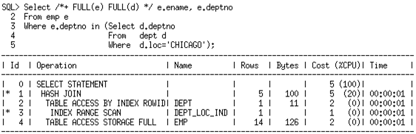
How to use Optimizer hints
Hints only apply to the query block in which they appear
The dept table only appears in the sub-query, which is treated as separate query block.
Hint has no effect

Slide 54
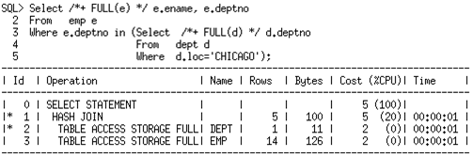
How to use Optimizer hints
Hints only apply to the query block in which they appear
The hint on dept now has an effect as it appears in the correct query block, the sub-query
Only exception are statement level hints

Slide 55
How to use Optimizer hints
Query block names
Oracle automatically names each query block in a SQL statement
  sel$1, ins$2, upd$3, del$4, cri$5, mrg$6, set$7, misc$8
  Displayed using ‘+alias’ format parameter in DBMS_XPLAN procedures
Query block names can be used to specify which block a hint applies to
  /*+ FULL(@SEL$2 D) */
The QB_NAME hint can be used to explicitly labels each query block
  /*+ QB_NAME(my_name_for_ block) */

Slide 56

How to use Optimizer hints
Query block names

Slide 57

How to use Optimizer hints
How do I know if my hints are used or not?
Any valid hint will be used
Can check if a hint is valid in hint section of 10053 trace
ERR indicates if there is an error with hint
USED indicates the hint was used during the evaluation of the part of the plan it pertains to
Doesn’t mean the final plan will reflect it

Slide 58

How to use Optimizer hints
Example showing how hints are used
Un-hinted SQL statement

Slide 59
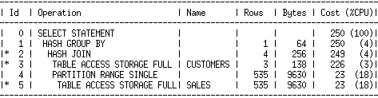
How to use Optimizer hints
Example showing how hints are used
Default plan is a hash join between sales and customers
We want the query to use a nested loops join

Slide 60
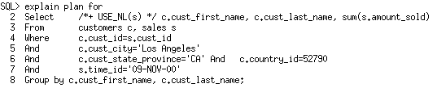
How to use Optimizer hints
Example showing how hints are used
Hinted SQL statement

Slide 61
How to use Optimizer hints
Example showing how hints are used
Even with hint we get hash join plan
Why did it not use the hint?

Slide 62

How to use Optimizer hints
Example showing how hints are used
Lets look in the 10053 trace file
Hint is valid and was used
Why did it not change the plan?
We only hinted the join method we didn’t hint the join order
Hint only valid when sales is on right side
Hint considered when join order was customer, sales but not when it was sales, customer

Slide 63
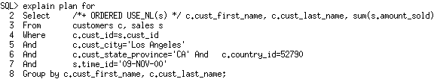
How to use Optimizer hints
Example showing how hints are used
Hinted SQL statement with both join method and join order hints

Slide 64
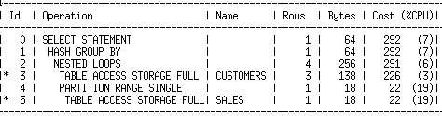
How to use Optimizer hints
Example showing how hints are used
Hinted plan

Slide 65
How to use Optimizer hints
Guaranteeing the same plan every time
Partial hints can’t guarantee the same plan every time
Only way to guarantee the same plan every time is with a full outline
A full outline is a complete set of hints for all aspects of a plan
Full outline for a plan can be displayed using ‘+outline’ option with FORMAT parameter in DBMS_XPLAN.DISPLAY_CURSOR
Select *
From table(DBMS_XPLAN.DISPLAY_CURSOR(format=>’ +outline’));

Slide 66
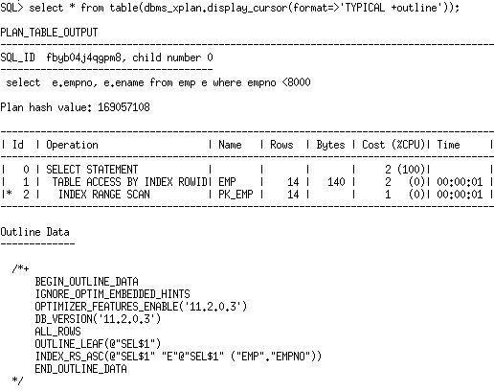
How to use Optimizer hints
Guaranteeing the same plan every time
Full outline for the plan

Slide 67
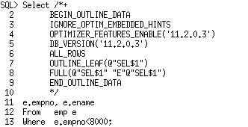
How to use Optimizer hints
Guaranteeing the same plan every time
Cut and paste full outline for the plan
Easier to maintain a full outline using SQL Plan Management

Slide 68
Changing initialization parameter for a query
OPT_PARAM hint
Allows value for init.ora Optimizer parameters to be changed for a specific query
Useful way to prevent setting non-default parameter value system-wide
Only the following Optimizer influencing init.ora parameters can be set:
OPTIMIZER_DYNAMIC_SAMPLING
OPTIMIZER_INDEX_CACHING
OPTIMIZER_INDEX_COST_ADJ
OPTIMIZER_USE_PENDING_STATISTICS
Optimizer related underscore parameters
STAR_TRANSFORMATION_ENABLED
PARALLEL_DEGREE_POLICY
PARALLEL_DEGREE_LIMIT

Slide 69
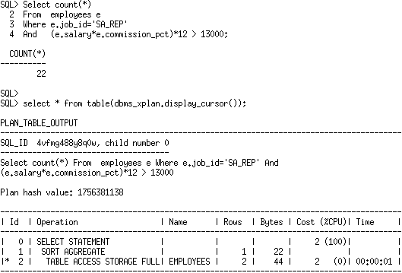
Changing initialization parameter for a query
OPT_PARAM hint example
Cardinality under-estimated due to complex expression
Extended statistics would help

Slide 70
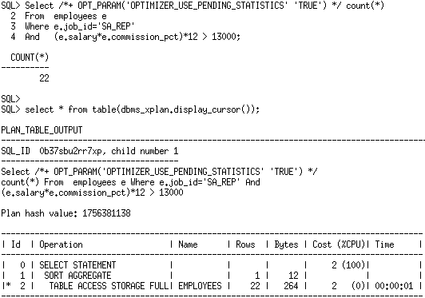
Changing initialization parameter for a query
OPT_PARAM hint example
Extended statistics created & statistics re-gathered as pending statistics OPT_PARAM hint enables pending statistics for only this statement

Slide 71
Changing Optimizer features enable
This parameter gets it own hint
OPTIMIZER_FEATURES_ENABLE parameter allows you to switch between optimizer versions
Setting it to previous database version reverts the Optimizer to that version
  Disables any functionality that was not present in that version
Easy way to work around unexpected behavior in a new release
Hint allows you to revert the Optimizer for just a single statement

Slide 72
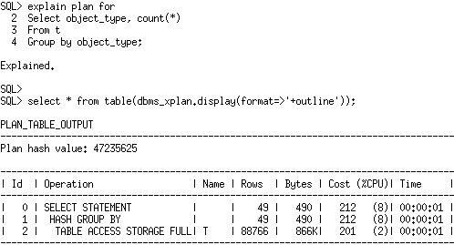
Changing Optimizer features enable
Example

Slide 73
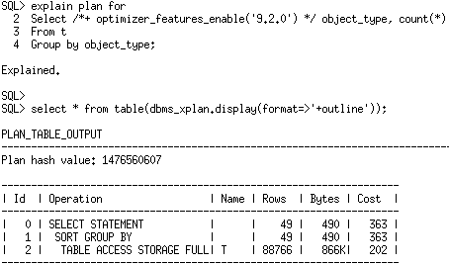
Changing Optimizer features enable
Example
Hash GROUP BY introduced in 10g not an option for 9.2 Optimizer so traditional sort based GROUP BY selected

Slide 74
Agenda
Using the right tools
Functions, friends or foes?
Data type dilemmas
Optimizer hints
  What are Optimizer hints
  How do you determine which hint is needs
  Why hints are not obeyed
Influencing the execution plan without adding hints

Slide 75
Determining which hints are need
Run SQL Tune Advisor
Ideally you should not have to manually intervene if the Optimizer picks a suboptimal plan
SQL Tuning Advisor available via Oracle Tuning Pack
  Monitors high load SQL via AWR
  Runs night tuning task to find more efficient plan
  More efficient plans implemented via SQL Profile
  A SQL Profile is contains auxiliary information that helps mitigates defects in the Optimizer or the inputs too it
  Can be manually invoked for problematic SQL statements

Slide 76
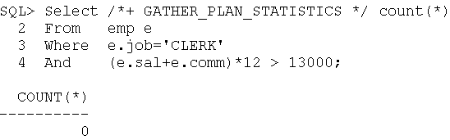
Determining which hints are need
Understanding the problem
Examine the execution plan and determine what aspect of the plan is suboptimal

Slide 77
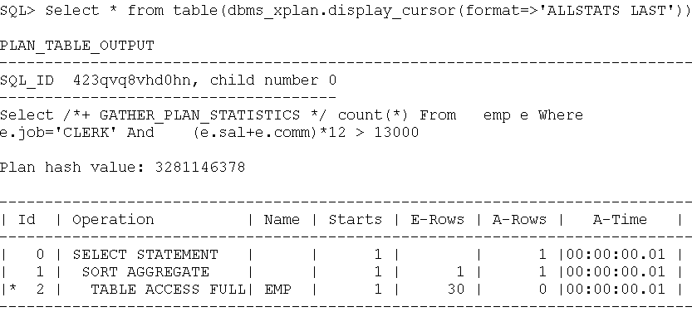
Determining which hints are need
Understanding the problem
Examine the execution plan and determine if cardinality estimates are accurate
Cardinality estimate is off due to correlation and complex predicate

Slide 78
Determining which hints are need
Understanding the problem
Can you fix it with statistics?
No extended statistics are only used with equality predicates
We have multiple single column predicates and a complex expression this time (e.sal+e.comm)*12
Solution in this case is dynamic sampling but what level do I need?

Slide 79
Dynamic Sampling Levels
Level | When Dynamic Sampling will be used | Sample size (blocks)
0 | Switches off dynamic sampling | N/A
1 | At least one non-partitioned table in the statement has no statistics | 32
2 (default) | One or more tables in the statement have no statistics | 64
3 | Any statement that meets level 2 criteria and has one or more expressions used in the where clause predicates e.g. Where substr(CUSTLASTNAME,1,3) or Where a + b =5 | 64
4 | Any statement that meets level 3 criteria and has complex predicates. An OR or AND operator between multiple predicates on the same table | 64
5 | Any statement that meets level 4 criteria | 128
6 | Any statement that meets level 4 criteria | 256
7 | Any statement that meets level 4 criteria | 512
8 | Any statement that meets level 4 criteria | 1024
9 | Any statement that meets level 4 criteria | 4086

Slide 80
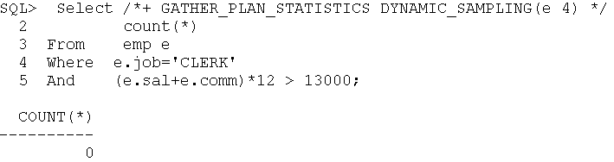
Determining which hints are need
Understanding the problem
Apply dynamic sampling hint with level 4

Slide 81
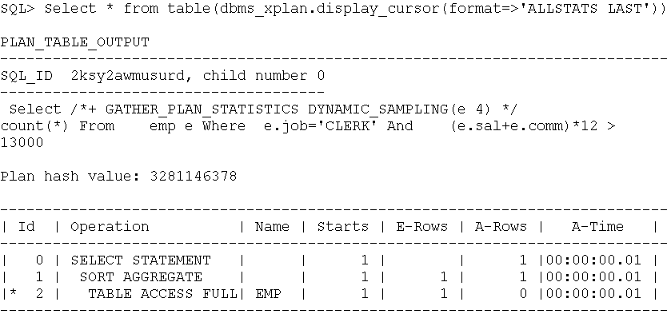
Determining which hints are need
Understanding the problem
Examine the execution plan and determine if cardinality estimates are accurate now
Cardinality estimate is now accurate as DS used at parse time to gather statistics on specific where clause predicates

Slide 82
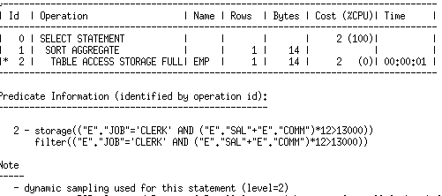
Determining which hints are need
Why does the note section shows a different dynamic sampling level?

Slide 83
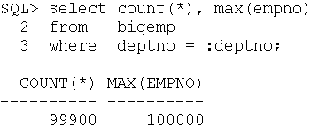
Determining which hints are need
Understanding the problem
But what if the access path is wrong?
Bigemp has100,000 rows and 99.9% of them have deptno = 10 Plan should be full table scan

Slide 84
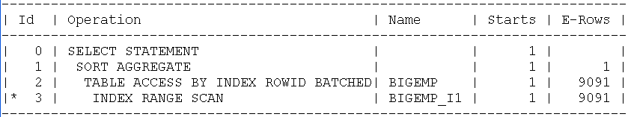
Determining which hints are need
Understanding the problem
In this case there is a skew in the data but the DBA won’t create histograms
The plan we got was is an index range scan

Slide 85
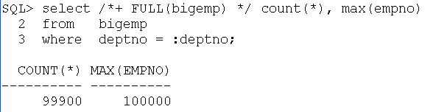
Determining which hints are need
Understanding the problem
To correct the plan we add a FULL hint to trigger a full table scan

Slide 86
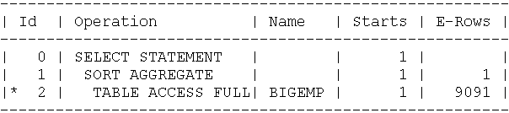
Determining which hints are need
Understanding the problem
Now check the plan to confirm the hint was accepted

Slide 87
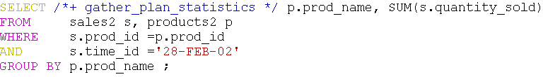
Determining which hints are need
Understanding the problem
But what if the join method is wrong?
Sales2 and Product2 are large tables and the join between them processes thousands of rows and should be a hash join

Slide 88
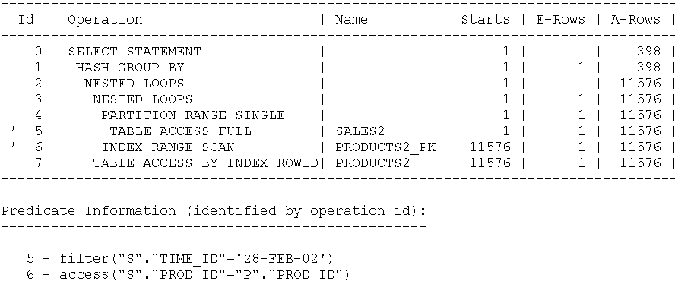
Determining which hints are need
Nested loops join chosen because the time_id specified in the query is outside min, max range Stats won’t be regathered until the weekend
Understanding the problem
The plan we got is a nested loops

Slide 89
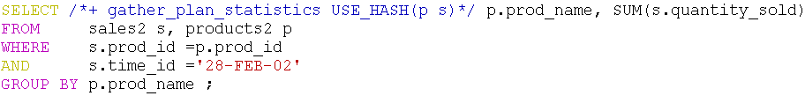
Determining which hints are need
Understanding the problem
To correct the plan we need to add the USE_HASH to force a hash join between Sales2 and product2
Force hash join with USE_HASH hint

Slide 90
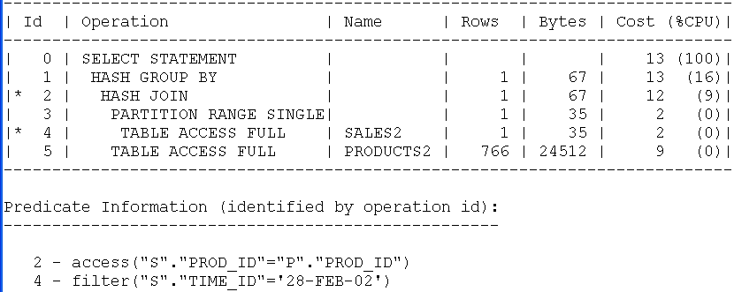
Determining which hints are need
Query is much more efficient now with hash join
Understanding the problem
Now check the plan to confirm the hint was accepted

Slide 91
Agenda
Using the right tools
Functions, friends or foes?
Data type dilemmas
Optimizer hints
  What are Optimizer hints
  How do you determine which hint is needs
  Why hints are not obeyed
Influencing the execution plan without adding hints

Slide 92


Why are Optimizer hints not obeyed?
Syntax and Spelling
Which one of the following hints will trigger the pk_emp index to be used in this query?
  Select /*+ ind(e pk_emp) */ * From emp e;
  Select /*+ index(e emp_pk) */ * From emp e;
  Select /*+ index(e pk_emp) */ * From emp e;

Slide 93
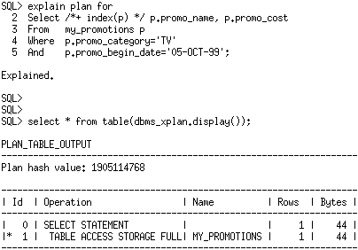
Why are Optimizer hints not obeyed?
Invalid hint
Specifying an index hint on a table with no indexes
Invalid hint because no indexes exist on the table

Slide 94
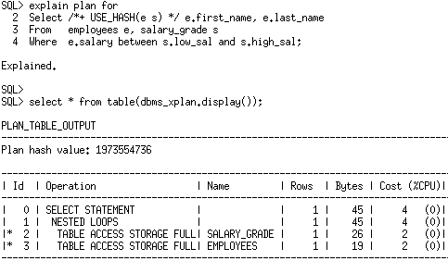
Why are Optimizer hints not obeyed?
Illegal hint
Specifying a hash join hint for non-equality join
Illegal hint because a hash join can’t be used for a non-equality join predicate

Slide 95
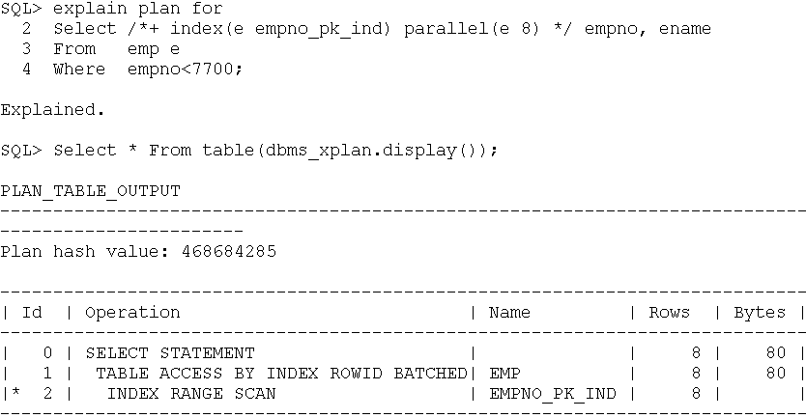
Why are Optimizer hints not obeyed?
Invalid hint combinations
Specifying a parallel hint for an index range scan
Invalid hint combination because an index range scan can’t be parallelized on non-partitioned table

Slide 96
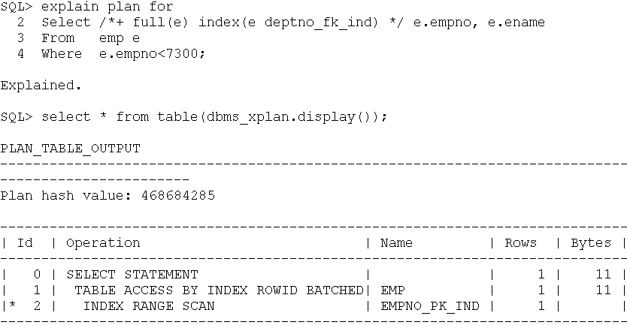
Why are Optimizer hints not obeyed?
Contradictory hints
If two hints contradict each other, they will both be ignored
Conflicting hints you can’t do a full table scan and index lookup on same table

Slide 97
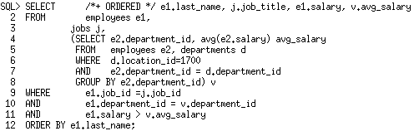
Why are Optimizer hints not obeyed?
Hint becomes invalid due to transformation
Ordered hint dictates the join order as the order of tables in FROM clause

Slide 98
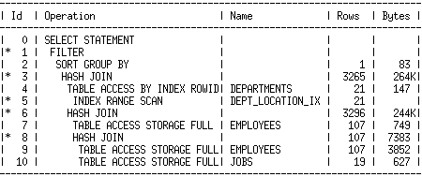
Why are Optimizer hints not obeyed?
View merging occurred
Order of tables in FROM clause (e1,j,v) lost
Optimizer picks join order with lowest cost
Hint becomes invalid due to transformation
Actual join order used
4
3
1
2

Slide 99
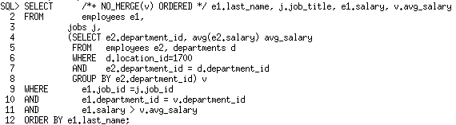
Why are Optimizer hints not obeyed?
Hint becomes invalid due to transformation
NO_MERGE hint prevents transformation from taking place
NO_MERGE hint preserves FROM clause order

Slide 100
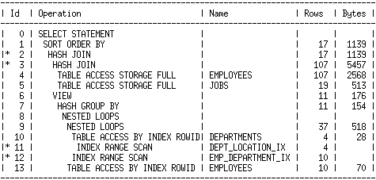
Why are Optimizer hints not obeyed?
Hint now valid because transformation prevented
Actual join order used
1
2
Inline View v
3

Slide 101
Agenda
Using the right tools
Functions, friends or foes?
Data type dilemmas
Optimizer hints
Influencing the execution plan without adding hints

Slide 102
If you can hint it, baseline it
Alternative approach to hints
Its not always possible to add hints to third party applications
Hints can be extremely difficult to manage over time
Once added never removed
Solution
Use SQL Plan Management (SPM)
Influence the execution plan without adding hints directly to queries
SPM available in EE, no additional options required

Slide 103



If you can hint it, baseline it
SQL Plan Management
GB
Plan Acceptable
Parse
Execute
Users
HJ
HJ
Plan history
Plan baseline
GB
HJ
HJ

Slide 104
If you can hint it, baseline it
SQL Plan Management
GB
Parse
Users
NL
NL
Plan history
Plan baseline
GB
NL
GB
HJ
NL
HJ

Slide 105
If you can hint it, baseline it
SQL Plan Management
GB
Plan Acceptable
Parse
Execute
Users
HJ
HJ
Plan history
Plan baseline
GB
NL
GB
HJ
NL
HJ

Slide 106
Influence execution plan without adding hints
Example Overview
Simple two table join between the SALES and PRODUCTS tables
Group By
Group By
HASH JOIN
HASH JOIN
TABLE ACCESS PRODUCTS
TABLE ACCESS SALES
INDEX RANGE SCAN PROD_SUPP_ID_INDX
TABLE ACCESS SALES
Current Plan
Desired Plan

Slide 107
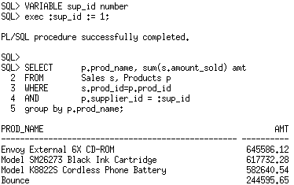
Influence execution plan without adding hints
Step 1. Execute the non-hinted SQL statement

Slide 108
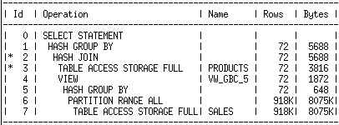
Influence execution plan without adding hints
Default plan is uses full table scans followed by a hash join

Slide 109
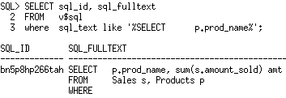
Influence execution plan without adding hints
Step 2. Find the SQL_ID for the non-hinted statement in V$SQL

Slide 110
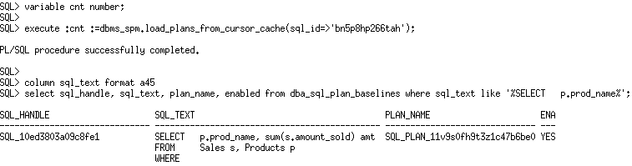
Influence execution plan without adding hints
Step 3. Create a SQL plan baseline for the non-hinted SQL statement

Slide 111
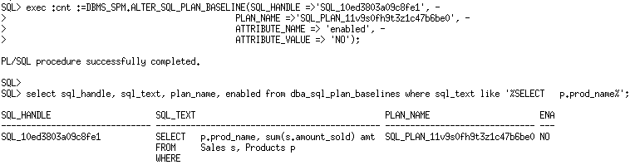
Influence execution plan without adding hints
Step 4. Captured Plan is not our desired plan so it should be disabled

Slide 112
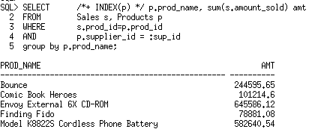
Influence execution plan without adding hints
Step 5. Modify the SQL statement to use the hint(s) & execute it

Slide 113
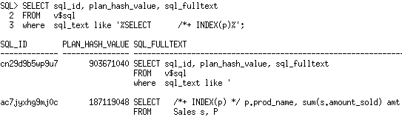
Influence execution plan without adding hints
Step 6. Find SQL_ID & PLAN_HASH_VALUE for hinted SQL stmt

Slide 114

Influence execution plan without adding hints
Step 7. Associate hinted plan with original SQL stmt’s SQL HANDLE
Sql_id & plan_hash_value belong to hinted statement
sql_handle is for the non-hinted statement

Slide 115
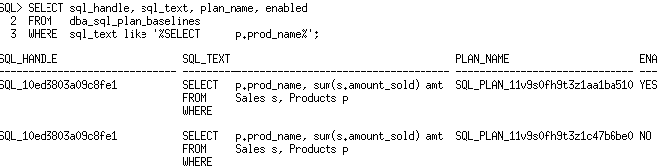
Influence execution plan without adding hints
Step 8. Confirm SQL stmt has two plans in it’s baseline
Hinted plan only accepted plan for non-hinted SQL stmt

Slide 116
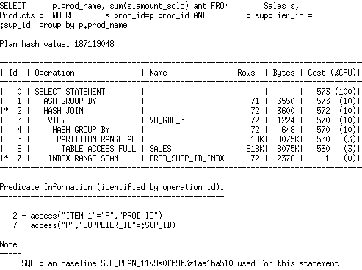
Influence execution plan without adding hints
Step 9. Confirm hinted plan is being used
Non-hinted SQL text but it is using the plan hash value for the hinted stmt
Note section also confirms SQL plan baseline used for stmt

Slide 117
Summary
Optimizer hints should only be used with extreme caution
To guarantee the same plan every time must supply a complete outline
Use _OPTIMIZER_IGNORE_HINTS parameter to test query performance without hints

