Slide 2
The following is intended to outline our general product direction. It is intended for information purposes only, and may not be incorporated into any contract. It is not a commitment to deliver any material, code, or functionality, and should not be relied upon in making purchasing decisions. The development, release, and timing of any features or functionality described for Oracle’s products remains at the sole discretion of Oracle.

Slide 3
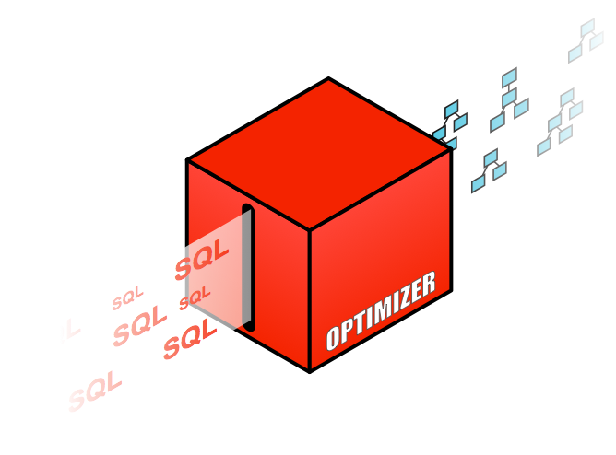
Oracle Optimizer One Day Workshop
Thomas Kyte
http://asktom.oracle.com/

Slide 4
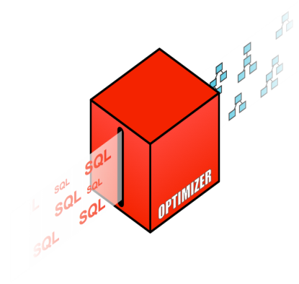
Quick History of Oracle Optimizer
CBO

Slide 5
What happens when a SQL statement is issued?
1
User
2
Oracle Database
Syntax Check
SQL Execution
Parsing
Semantic Check
4
Shared Pool check
Dictionary
Shared Pool
3
Optimizer
Library Cache
Shared SQL Area
…
C1
C2
Cn
Code Generator

Slide 6
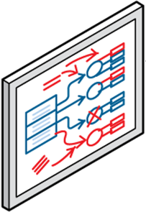
“ In the beginning there were rules …”
RBO
1979-1991

Slide 7
Rule Based Optimizer
Oracle Version 6 and earlier
Rule Based Optimizer (RBO) is a heuristic based Optimizer
Uses a ranked list of access paths (rules)
17 possible access paths
Lower ranked access paths assumed to operate more efficiently
Plans chosen based on access paths available and their rank
If multiple access paths existed path with the lowest rank chosen
Only very simple physical optimizations done automatically
OR Expansion: multiple OR predicates rewritten as UNION ALL

Slide 8
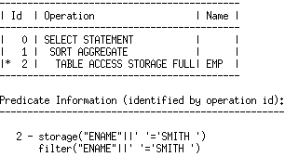
Famous tricks to work around RBO
Got an index access but want a full table scan
SELECT count(*) FROM emp
WHERE ename || ’’ = ‘SMITH’;
Only way to influence RBO was to change the SQL text
Concatenating an empty string to the column prevents the index from being used

Slide 9
Dawn of a new era: “ .. there is cost .. “
1992

Slide 10
Cost Based Optimizer
Oracle 7 - dawn of a new era
Database features become more and more complex
Partitioning
Parallel execution
No easy way to extend Rule Based Optimizer to accommodate so many additional access paths
Having only one plan per statement regardless of the objects size or structure was no longer the best approach
Optimizer must evolve to become cost based

Slide 11
Cost Based Optimizer
Oracle 7 - dawn of a new era
Initial design based on IBM research paper
Access Path Selection in a Relational Database Management System (1979)
Approach outlined in the paper was
Multiple execution plans generated for a statement
Estimated cost is computed for each plan
Optimizer selects the plan with the lowest estimated cost

Slide 12
Understanding how the Optimizer works
Optimizer
Data Dictionary
Query Transformation
Rewrite query text to allow it to be processed more efficiently
Schema definitions
Statistics
Plan Generator
Multiple plans are generated for each SQL, using different access paths and join types. Each plan is costed and plan with the lowest cost is used.
Cost Estimator
Cost is an estimate of the amount of CPU and the number of disk I/Os, used to perform an operation

Slide 13
Optimizer Transformations
Translate statements into semantically equivalent SQL that can be processed more efficiently
Initial transformations were heuristic based
Applied to SQL statements based on their structural properties only
Predominately cost based now
Transformations include
Subquery Unnesting
View Merging
OR Expansion
Star transformation

Slide 14
Subquery Unnesting
SELECT C.cust_last_name, C.country_id
FROM customers C
WHERE Exists(SELECT null
FROM sales S
WHERE C.cust_id=S.cust_id
AND s.quantity_sold > 1000);
A correlated subquery is one that refers to a column from a table outside the subquery
In this case C.cust_id is referenced in the subquery
Without subquery unnesting the correlated subquery must be evaluated for each row in the Customers tables

Slide 15
Subquery Unnesting
Query gets transformed as follows
SELECT C.cust_last_name, C.country_id
FROM customers C
WHERE C.cust_id =
ANY(SELECT S.cust_id
FROM sales S
WHERE S.quantity_sold > 1000);
Transformation rewrites the EXISTS subquery to an ANY subquery
ANY subquery is no longer correlated
Any subquery returns a set of cust_id if any match the predicate will return true

Slide 16
Subquery Unnesting
Transformation allows subquery to be evaluated as a SEMI join
Subquery returns a set of cust_id and those cust_id are joined to the customers table via a SEMI Hash Join

Slide 17
Complex View Merging
Create View cust_prod_totals_v as
Select sum(s.quantity_sold) total, s.cust_id, s.prod_id
from sales s
group by s.cust_id, s.prod_id;
Select c.cust_id, c.cust_first_name, c.cust_last_name
from customers c, cust_prod_totals_v v, products p
where c.country_id = 'US'
and c.cust_id = v.cust_id
and v.total > 100
and v.prod_id = p.prod_id
and p.prod_name = 'T3 Faux Fur-Trimmed Sweater';
Complex view merging refers to the merging of group by and distinct views
Allows the optimizer to consider additional join orders and access paths
Group-by/distinct operations can be delayed until after the joins have been evaluated

Slide 18
Complex View Merging
Query gets transformed as follows
select c.cust_id, cust_first_name, cust_last_name
from customers c, products p, sales s
where c.country_id = 'US'
and c.cust_id = s.cust_id
and s.prod_id = p.prod_id
and p.prod_name = 'T3 Faux Fur-Trimme…’
group by s.cust_id, s.prod_id, p.rowid,
c.rowid, c.cust_last_name,
c.cust_first_name, c.cust_id
having sum(s.quantity_sold) > 100;
After transformation group by operation occurs after Sales is joined to Products and Customers
Number of rows in group by greatly reduced after join
May not always be best to delay the group by / distinct operation so transformation is cost based*
*Compare the cost of the best plan with and without the transformation

Slide 19
OR Expansion
SELECT * FROM products WHERE prod_category ='Photo'
OR prod_subcategory ='Camera Media';
Transforms queries that contain OR predicates into the form of a UNION ALL query of two or more branches
Without the transformation Optimizer treats OR predicates as a single unit
Can’t use index on either column

Slide 20
OR Expansion
Query gets transformed as follows
SELECT * FROM products WHERE prod_subcategory ='Camera Media‘
UNION ALL
SELECT * FROM products WHERE prod_category ='Photo'
AND lnnvl(prod_subcategory =
'Camera Media');
*lnnvl(true) is FALSE, lnnvl(false||null) is TRUE
The transformation adds an LNNVL() function to the second branch in order to avoid duplicates being generated across branches
The LNNVL function returns TRUE, if the predicate evaluates to FALSE or if the predicate involves NULL; otherwise it will return FALSE

Slide 21
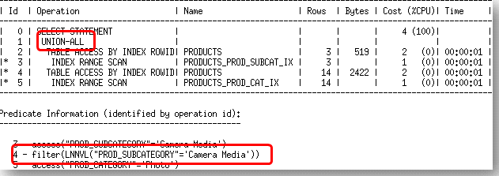
OR Expansion
Transformation allows an index access to be considered for each branch of the UNION ALL

Slide 22
Star Query Transformation
Customers
Dimension
Cost-based* transformation designed to execute star queries more efficiently
Relies on bitmap indexes on foreign key columns to access rows in the fact table
Controlled by parameter STAR_TRANSFORMATION_ENABLED
Suppliers
Dimension
Sales Fact Table
Products
Dimension
Geography
Dimension
Time
Dimension
Star Schema - one or more large fact table
and many smaller dimension tables
*Compares the cost of the best plan with and without the transformation

Slide 23
Star Query Transformation
SELECT *
FROM fact, d1, d2, d3
WHERE fact.c1 = d1.c1
AND fact.c2 = d2.c1
AND fact.c3 = d3.c1
AND d1.c2 IN (1, 2, 3, 4)
AND d2.c2 < 100
AND d3.c2 = 35;
Traditionally a star query only defines predicates on the dimension tables
No efficient way to access rows in the fact table
By rewriting the query new access paths become available on the fact table

Slide 24
Star Query Transformation
Query gets transformed as follows
SELECT *
FROM fact, d1, d2, d3
… exactly as before …
AND fact.c1 IN (SELECT d1.c1
FROM d1
WHERE d1.c2 IN (1, 2, 3, 4) )
AND fact.c2 IN (select d2.c1
FROM d2
WHERE d2.c2 < 100)
AND fact.c3 IN (SELECT d3.c1
FROM d3
WHERE d3.c2 = 35)
Converts original query to include 3 sub-queries on the fact
Fact table accessed first via bitmap index and then joins out to dimension tables
Result of sub-queries may be saved in temp tables

Slide 25
Understanding how the Optimizer works
Optimizer
Data Dictionary
Query Transformation
Rewrite query text to allow it to be processed more efficiently
Schema definitions
Statistics
Plan Generator
Multiple plans are generated for each SQL, using different access paths and join types. Each plan is costed and plan with the lowest cost is used.
Cost Estimator
Cost is an estimate of the amount of CPU and the number of disk I/Os, used to perform an operation
Controlled by OPTIMIZER_FEATURES_ENABLED
Notes:
Example of features controlled by ofe is hash group by versus sort group by
Different transformations also controlled by OFE

Slide 26
Q&A

