Slide 1
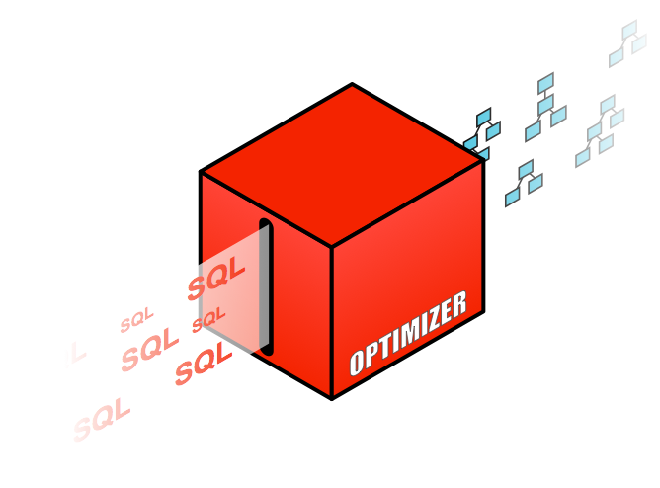
Understanding Optimizer Statistics

Slide 2
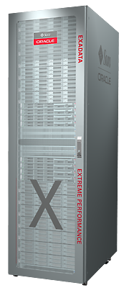
Optimizer Statistics
CPU & IO
Constraints
Optimizer
DATA DICTIONARY
OPTIMIZER STATISTICS
Index Table Column System
PROMO_ID | PROMO_NAME | … | PROMO_DATE
1 | Promo_1 | … | 15-NOV-98
2 | Promo_1 | … | 31-DEC-98
GB
HJ
PROMO_PK Index
HJ
Execution plan
PROMOTIONS Table

Slide 3
Agenda
How to gather statistics
What basic statistics to collect
Additional statistics
When to gather statistics
Statistics gathering performance
When not to gather statistics
Other types of statistics

Slide 4
How to gather statistics
Use DBMS_STATS Package
Analyze command is deprecated
Only good for row chaining
The GATHER_*_STATS procedures take 13 parameters
Ideally you should only set 2-4 parameters
SCHEMA NAME
TABLE NAME
PARTITION NAME
DOP

Slide 5
How to gather statistics
Use DBMS_STATS Package
Your gather statistics commands should be this simple

Slide 6
How to gather statistics
Changing Default Parameter Values for Gathering Statistics
Occasionally default parameter values may need to change
For example - features not automatically on by default
Incremental Statistics
Ability to accurate generate global statistics from partition level statistics
Controlled by the parameter INCREMENTAL (default is FALSE)
Concurrent Statistics Gathering
Ability to gather statistics on multiple objects concurrently under a GATHER_SCHEMA_STATS command
Controlled by the parameter CONCURRENT (default is FALSE)

Slide 7
How to gather statistics
Changing Default Parameter Values for Gathering Statistics
Can change the default value at the global level
DBMS_STATS.SET_GLOBAL_PREF
This changes the value for all existing objects and any new objects
Can change the default value at the table level
DBMS_STATS.SET_TABLE_PREF

Slide 8
How to gather statistics
Changing Default Parameter Values for Gathering Statistics
Can change the default value at the schema level
DBMS_STATS.SET_SCHEMA_PREF
Current objects in the schema only
New objects pick up global preferences
Can change the default value at the database level
DBMS_STATS.SET_DATABASE_PREF
Current objects in the Database only
New objects pick up global preferences

Slide 9
How to gather statistics
Changing Default Parameter Values for Gathering Statistics
The following parameter defaults can be changed:
CASCADE
CONCURRENT
DEGREE
ESTIMATE_PERCENT
GRANULARITY
INCREMENTAL
METHOD_OPT
PUBLISH
STALE_PERCENT
AUTOSTATS_TARGET (SET_GLOBAL_PREFS only)

Slide 10
How to gather statistics
Hierarchy for Parameter Values
DBMS_STATS.GATHER_*_STATS Parameter hierarchy
Parameter values explicitly specified in the gather statistics command
Table level preferences
Global preferences

Slide 11
How to gather statistics
Sample Size
# 1 most commonly asked question
“What sample size should I use?”
Controlled by ESTIMATE_PRECENT parameter
From 11g onwards use default value AUTO_SAMPLE_SIZE
New hash based algorithm
Speed of a 10% sample
Accuracy of 100% sample
More info in the following paper http://dl.acm.org/citation.cfm?id=1376721

Slide 12
How to gather statistics
Sample Size
Speed of a 10% sample
Accuracy of 100% sample
Run Num | AUTO_SAMPLE_SIZE | 10% SAMPLE | 100% SAMPLE
1 | 00:02:21.86 | 00:02:31.56 | 00:08:24.10
2 | 00:02:38.11 | 00:02:49.49 | 00:07:38.25
3 | 00:02:39.31 | 00:02:38.55 | 00:07:37.83
Column Name | NDV with AUTO_SAMPLE_SIZE | NDV with 10% SAMPLE | NDV with 100% SAMPLE
C1 | 59852 | 31464 | 60351
C2 | 1270912 | 608544 | 1289760
C3 | 768384 | 359424 | 777942

Slide 13
Agenda
How to gather statistics
What basic statistics to collect
Additional statistics
When to gather statistics
Statistics gathering performance
When not to gather statistics
Other types of statistics

Slide 14
What basic statistics to collect
By default the following basic table & column statistic are collected
Number of Rows
Number of blocks
Average row length
Number of distinct values
Number of nulls in column

Slide 15
What basic statistics to collect
Index statistics are automatically gathered during creation and maintained by GATHER_TABLE_STATS and include
Number of leaf blocks
Branch Levels
Clustering factor
12c – Tables have basic statistics gathered during loads into empty segments too

Slide 16
What basic statistics to collect
Histograms
Histograms tell Optimizer about the data distribution in a Column
Creation controlled by METHOD_OPT parameter
Default create histogram on any column that has been used in the WHERE clause or GROUP BY of a statement AND has a data skew
Relies on column usage information gathered at compilation time and stored in SYS.COL_USAGE$

Slide 17
What basic statistics to collect
Histograms
11g and before - Two types of histograms
Frequency
Height-balanced
12c and after – two more
Top Frequency
Hybrid

Slide 18
Histograms
Frequency histograms (FREQUENCY)
A frequency histogram is only created if the number of distinct values in a column (NDV) is less than 254 values
Oracle Confidential

Slide 19
Histograms
Height balanced histograms (HEIGHT BALANCED)
A height balanced histogram is created if the number of distinct values in a column (NDV) is greater than 254 values

Slide 20
Histograms
Top Frequency (TOP-FREQUENCY) 12c
Traditionally a frequency histogram is only created if NDV < 254
But if a small number of values occupies most of the rows (>99% rows)
Creating a frequency histograms on that small set of values is very useful even though NDV is greater than 254
Ignores the unpopular values to create a better quality histogram for popular values
Built using the same technique used for frequency histograms
Only created with AUTO_SAMPLE_SIZE

Slide 21
Histograms
Hybrid Histograms (HYBRID) 12c
Similar to height balanced histogram as created if the NDV >254
Store the actual frequencies of bucket endpoints in histograms
No values are allowed to spill over multiple buckets
More endpoint values can be squeezed in a histogram
Achieves the same effect as increasing the # of buckets
Only created with AUTO_SAMPLE_SIZE

Slide 22
How to gather statistics
Why people hate histograms
Two main hurt points with Histograms
Bind peeking interacts with histograms
Nearly popular values

Slide 23
Bind peeking and histograms prior to 11g
The optimizer peeks bind values during plan selection
Initial value of the binds determines the plan
Same execution plan shared regardless of future bind values
Potential for plan changes when the first value peeked is popular or unpopular

Slide 24
Bind peeking and histograms prior to 11g
Select count(*), max(empno)From emp Where deptno = :deptno;
Count(*) | Max(empno)
10 | 99
If the value of bind deptno is 9 at hard parse
An index range scan will be selected because there are only 10 employees in deptno 9 out 100,000
Employee Table (100,000 rows)
Last_name
Empno
Deptno
SMITH
6973
10
ALLEN
7499
10
WARD
7521
10
KING
8739
9
SCOTT
7788
10
CLARK
7782
10

Slide 25
Bind peeking and histograms prior to 11g
Select count(*), max(empno)From emp Where deptno = :deptno;
Count(*) | Max(empno)
99,900 | 100,000
If the value of bind deptno is 10 at hard parse
A full table scan will be selected because there are only 99,900 employees in deptno 10 out 100,000
Employee Table (100,000 rows)
Last_name
Empno
Deptno
SMITH
6973
10
ALLEN
7499
10
WARD
7521
10
KING
8739
9
SCOTT
7788
10
CLARK
7782
10

Slide 26
Solutions for bind peeking and histograms
Prior to 11g
Applications that only have statements with binds
Drop histogram using DBMS_STATS.DELETE_COL_STATS
Use DBMS_STATS.SET_PARM to change default setting for method_opt parameter to prevent histogram from being created
Re-gather statistics on the table without histogram
Applications that have statements with bind and literals
Switch off bind peeking _optim_peek_user_binds = false

Slide 27
With Adaptive Cursor Sharing
You Can Have BOTH Plans For Our Statement
Select count(*), max(empno)From emp Where deptno = :deptno;
Deptno=9
Deptno=10
Peek all binds & take the plan that is optimal for each bind set

Slide 28
Adaptive Cursor Sharing
Share the plan when binds values are “equivalent”
Plans are marked with selectivity range
If current bind values fall within range they use the same plan
Create a new plan if binds are not equivalent
Generating a new plan with a different selectivity range
Controlled by init.ora parameter _optim_peek_user_binds
Monitoring - V$SQL has 2 new columns
IS_BIND_SENSITIVE - Optimizer believes the plan may depend on the value of bind
IS_BIND_AWARE - Multiple execution plans exist for this statement

Slide 29
Adaptive Cursor Sharing
First execution deptno set 9
Execution plan shows index range scan

Slide 30
Adaptive Cursor Sharing
In V$SQL you see the cursor is mark is_bind_sensitive
Cursor is marked is_bind_sensitive when plan is suspected to be influenced by bind value
Histogram present on column used with the bind variable
Bind variable used with non-equality or range predicate

Slide 31
Adaptive Cursor Sharing
Second execution deptno set 10
Execution plan still shows index range scan

Slide 32
Adaptive Cursor Sharing
In V$SQL you see
Number of buffer gets increased dramatically
Cursor is now candidate for Adaptive Cursor Sharing
Triggers the cursor to be marked un-sharable
Statement will be hard parsed again on next execution

Slide 33
Adaptive Cursor Sharing
Third execution deptno set 10
Execution plan now shows full table scan

Slide 34
Adaptive Cursor Sharing
In V$SQL you see
New child cursor marked is_bind_sensitive and is_bind_aware and has a selectivity range assigned to it
Now each bind will be peeked
If selectivity of the bind falls in range it uses cursor otherwise hard parse

Slide 35
How to gather statistics
Why people hate histograms
Two main hurt points with Histograms
Bind peeking interacts with histograms
Nearly popular values

Slide 36
Nearly popular values
Nearly popular value means the value is classified as non-popular but the density calculation is not accurate for them
Same estimate used as for non-popular. Here density is not good enough to get accurate cardinality estimate

Slide 37
Nearly popular values
Solution dynamic sampling
To get an accurate cardinality estimate for nearly popular values use dynamic sampling

Slide 38
Agenda
How to gather statistics
What basic statistics to collect
Additional statistics
When to gather statistics
Statistics gathering performance
When not to gather statistics
Other types of statistics

Slide 39
Additional statistics
When table and column statistics are not enough
Two types of Extended Statistics
Column groups statistics
Column group statistics useful when multiple column from the same table are used in where clause predicates
Expression statistics
Expression statistics useful when a column is used as part of a complex expression in where clause predicate
Can be manually or automatically created
Automatically maintained when statistics are gathered on the table

Slide 40
Extended Statistics – column group statistics
SELECT * FROM vehicles WHERE model = ‘530xi’
AND color = 'RED’;
MAKE | MODEL | COLOR
BMW | 530xi | RED
Cardinality #ROWS * 1 * 1 12 * 1 * 1 1 NDV c1 NDV c2 4 3
=
=>
=
Vehicles Table
Make
Model
Color
BMW
530xi
RED
BMW
530xi
BLACK
BMW
530xi
SILVER
PORSCHE
911
RED
MERC
SLK
RED
MERC
C320
SILVER

Slide 41
Extended Statistics – column group statistics
SELECT * FROM vehicles WHERE model = ‘530xi’
AND make= ‘BMW’;
MAKE | MODEL | COLOR
BMW | 530xi | RED
BMW | 530xi | BLACK
BMW | 530xi | SILVER
Vehicles Table
=
=>
=
Make
Model
Color
Cardinality #ROWS * 1 * 1 12 * 1 * 1 1 NDV c1 NDV c2 4 3
BMW
530xi
RED
BMW
530xi
BLACK
BMW
530xi
SILVER
PORSCHE
911
RED
MERC
SLK
RED
MERC
C320
SILVER

Slide 42
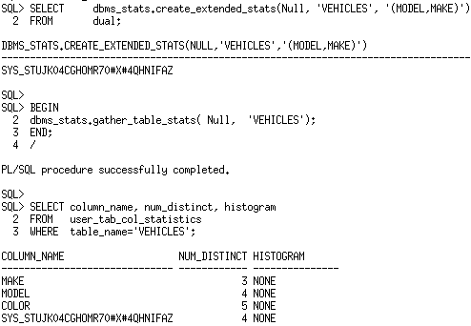
Extended Statistics – column group statistics
Create extended statistics on the Model & Make columns using DBMS_STATS.CREATE_EXTENDED_STATS
New Column with system generated name

Slide 43
Extended Statistics – column group statistics
SELECT * FROM vehicles WHERE model = ‘530xi’
AND make = ‘BMW’;
MAKE | MODEL | COLOR
BMW | 530xi | RED
BMW | 530xi | BLACK
BMW | 530xi | SILVER
Vehicles Table
Cardinality calculated using column group statistics
Make
Model
Color
BMW
530xi
RED
BMW
530xi
BLACK
BMW
530xi
SILVER
PORSCHE
911
RED
MERC
SLK
RED
MERC
C320
SILVER

Slide 44
Extended Statistics – expression statistics example
SELECT *
FROM Customers
WHERE UPPER(CUST_LAST_NAME) = ‘SMITH’;
Optimizer doesn’t know how function affects values in the column
Optimizer guesses the cardinality to be 1% of rows
SELECT count(*) FROM customers;
COUNT(*)
55500
Cardinality estimate is 1% of the rows

Slide 45
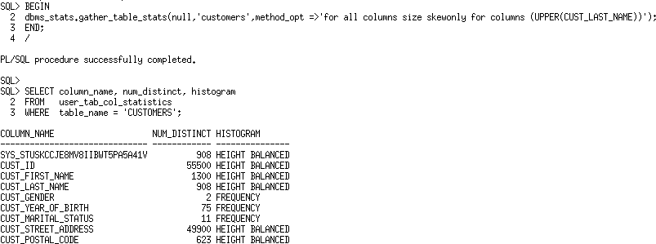
Extended Statistics – expression statistics solution
New Column with system generated name

Slide 46
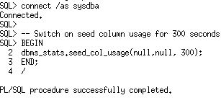
Extended Statistics
Automatic column group detection
Start column group usage capture
Switches on monitoring for 300 seconds or the next 5 minutes. Any statement executed will be monitored for columns used in the where and group by clauses

Slide 47
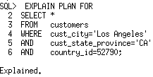
Extended Statistics
Automatic column group detection
Run your workload
Actual number of rows returned by this query 932. Optimizer underestimates because it assumes each predicate will reduce num rows

Slide 48
Extended Statistics
Actual number of rows returned by this query 145. Optimizer overestimates because it assumes no relationship between country and state
Automatic column group detection
Run your workload

Slide 49
Extended Statistics
Automatic column group detection
Check we have column usage information for our table
SQL> SELECT dbms_stats.report_col_usage(user, 'customers') FROM dual;
COLUMN USAGE REPORT FOR SH.CUSTOMERS
1. COUNTRY_ID : EQ
2. CUST_CITY : EQ
3. CUST_STATE_PROVINCE : EQ
4. (CUST_CITY, CUST_STATE_PROVINCE, COUNTRY_ID) : FILTER
5. (CUST_STATE_PROVINCE, COUNTRY_ID) : GROUP_BY
EQ means column was used in equality predicate in query 1
FILTER means columns used together as filter predicates rather than join etc. Comes from query 1
GROUP_BY columns used in group by expression in query 2

Slide 50
Extended Statistics
Automatic column group creation
Create extended stats for customers based on usage
SQL> SELECT dbms_stats.create_extended_stats(user, 'customers') FROM dual;
EXTENSIONS FOR SH.CUSTOMERS
(CUST_CITY, CUST_STATE_PROVINCE, COUNTRY_ID):
SYS_STUMZ$C3AIHLPBROI#SKA58H_N created
(CUST_STATE_PROVINCE, COUNTRY_ID) : SYS_STU#S#WF25Z#QAHIHE#MOFFMM_ created
Column group statistics will now be automatically maintained every time you gather statistics on this table

Slide 51
Agenda
How to gather statistics
What basic statistics to collect
Additional statistics
When to gather statistics
Statistics gathering performance
When not to gather statistics
Other types of statistics

Slide 52
When to gather statistics
Automatic statistics gathering
Oracle automatically collect statistics for all database objects, which are missing statistics or have stale statistics
AutoTask run during a predefined maintenance window
Internally prioritizes the database objects
Both user schema and dictionary tables
Objects that need updated statistics most are processed first
Controlled by DBMS_AUTO_TASK_ADMIN package or via Enterprise Manager

Slide 53
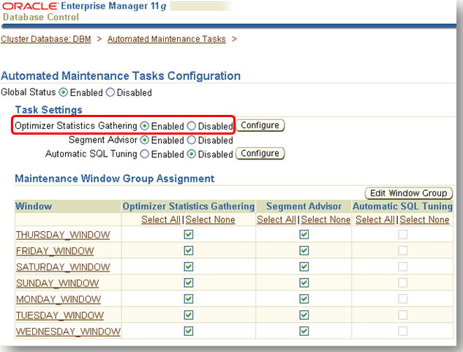
Automatic statistics gathering

Slide 54
Automatic statistics gathering
If you want to disable auto job for application schema consider leaving it on for Oracle dictionary tables
The scope of the auto job is controlled by the global preference AUTOSTATS_TARGET
Possible values are
AUTO Oracle decides what tables need statistics (Default)
All Statistics gathered for all tables in the system
ORACLE Statistics gathered for only the dictionary tables

Slide 55
When to gather statistics
If the auto statistics gather job is not suitable
Partitioned Table
After a large data load
As part of the ETL or ELT process gather statistics
If trickle loading into a partition table
Used dbms.stats.copy_table_stats()
Copies stats from source partition
Adjust min & max values for partition column
Both partition & global statistics
Copies statistics of the dependent objects
Columns, local (partitioned) indexes* etc.
Partition 1 Oct 1st 2012
:
Partition 4 Oct 4th 2012
Partition 5 Oct 5th 2012
Note*:Does not update global indexes

Slide 56
Agenda
How to gather statistics
What basic statistics to collect
Additional statistics
When to gather statistics
Statistics gathering performance
When not to gather statistics
Other types of statistics

Slide 57
Statistics gathering performance
How to speed up statistics gathering
Three parallel options to speed up statistics gathering
Intra object using parallel execution
Inter object using concurrency
The combination of Inter and Intra object
Incremental statistics gathering for partitioned tables

Slide 58
Statistics gathering performance
Intra object using parallel execution
Controlled by GATHER_*_STATS parameter DEGREE
Default is to use parallel degree specified on object
If set to AUTO Oracle decide parallel degree used
Works on one object at a time

Slide 59
Statistics gathering performance
Intra object using parallel execution
Customers table has a degree of parallelism of 4
4 parallel server processes will be used to gather stats
Customers Table
P1
P2
P3
P4

Slide 60
Statistics gathering performance
Intra object using parallel execution
Exec DBMS_STATS.GATHER_TABLE_STATS(null, ‘SALES’);
Sales Table
Each individual partition will have statistics gathered one after the other
P1
Partition 1
Oct 1st 2011
P2
P3
P4
Partition 2
Oct 2nd2011
The statistics gather procedure on each individual partition operates in parallel BUT the statistics gathering procedures won’t happen concurrently
Partition 3
Oct 3rd 2011

Slide 61
Statistics gathering performance
Inter object
Gather statistics on multiple objects at the same time
Controlled by DBMS_STATS preference, CONCURRENT
Uses Database Scheduler and Advanced Queuing
Number of concurrent gather operations controlled by job_queue_processes parameter
Each gather operation can still operate in parallel

Slide 62
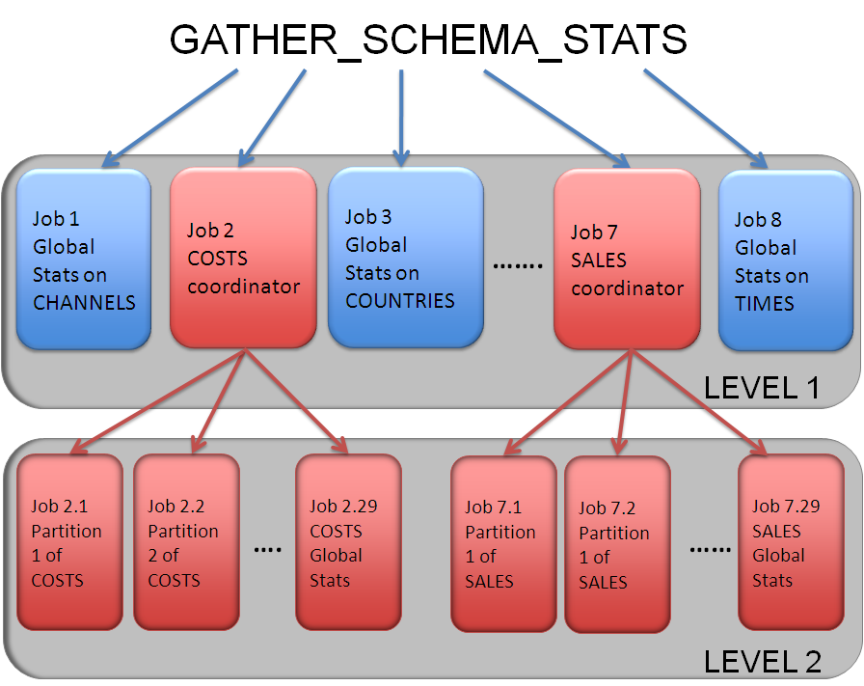
Statistics gathering performance
Intra object statistics gathering for SH schema
Exec DBMS_STATS.GATHER_SCHEMA_STATS(‘SH’);
A separate statistics gathering job is created for each table and each partition in the schema
Level 1 contain statistics gathering jobs for all non-partitioned tables and a coordinating job for each partitioned table
Level 2 contain statistics gathering jobs for each partition in the partitioned tables

Slide 63
Statistics gathering performance
Inter and intra working together for partitioned objects
Exec DBMS_STATS.GATHER_SCHEMA_STATS(‘SH’);
Sales Table
The number of concurrent gathers is controlled by the parameter job_queue_processes
In this example it is set to 3
Partition 1
Oct 1st 2011
Partition 2
Oct 2nd2011
Remember each concurrent gather operates in parallel
In this example the parallel degree is 4
Partition 3
Oct 3rd 2011

Slide 64
Statistics gathering performance
Incremental statistics gathering for partitioned tables
Typically gathering statistics after a bulk loading data into one partition would causes a full scan of all partitions to gather global table statistics
Extremely time consuming
With Incremental Statistic gather statistics for touched partition(s) ONLY
Table (global) statistics are accurately built from partition statistics
Reduce statistics gathering time considerably
Controlled by INCREMENTAL preference

Slide 65
Incremental statistics gathering
Sales Table
1. Partition level stats are gathered & synopsis created
May 18th 2011
S1
May 19th 2011
2. Global stats generated by aggregating partition level statistics and synopsis
S2
May 20th 2011
S3
Global Statistic
May 21st 2011
S4
May 22nd 2011
S5
May 23rd 2011
S6
Sysaux Tablespace

Slide 66
Incremental statistics gathering
Sales Table
3. A new partition is added to the table & Data is Loaded
May 18th 2011
S1
May 19th 2011
6. Global stats generated by aggregating the original partition synopsis with the new one
S2
May 20th 2011
S3
Global Statistic
May 21st 2011
S4
May 22nd 2011
S5
5. Retrieve synopsis for each of the other partitions from Sysaux
May 23rd 2011
4. Gather partition statistics for new partition
S6
May 24th 2011
Sysaux Tablespace
S7

Slide 67
Agenda
How to gather statistics
What basic statistics to collect
Additional statistics
When to gather statistics
Statistics gathering performance
When not to gather statistics
Other types of statistics

Slide 68
When not to gather statistics
Volatile Tables
Volume of data changes dramatically over a period of time
For example orders queue table
Starts empty, orders come in, order get processed, ends day empty
Global Temp Tables
Application code stores intermediate result
Some session have a lot of data, some have very little
Intermediate work tables
Written once, read once and then truncated or deleted
For example part of an ETL process

Slide 69
When not to gather statistics
Volatile tables
Data volume changes dramatically over time
When is a good time to gather statistics?
Gather statistics when the table has a representative data volume
Lock statistics to ensure statistics gathering job does not over write representative statistics

Slide 70
When not to gather statistics
Intermediate work tables
Often seen as part of an ETL process
Written once, read once, and then truncated or deleted
When do you gather statistics?
Don’t gather statistics it will only increase ETL time
Use Dynamic sampling
Add dynamic sampling hint to SQL statements querying the intermediate table

Slide 71
When not to gather statistics
Intermediate work tables
Add dynamic sampling hint or set it at the session or system level

Slide 72
Agenda
How to gather statistics
What basic statistics to collect
Additional statistics
When to gather statistics
Statistics gathering performance
When not to gather statistics
Other types of statistics

Slide 73
Other types of statistics
Dictionary Statistics
Fixed Object Statistics
System Statistics
Automatic Dynamic Sampling

Slide 74
Dictionary statistics
Statistics on dictionary tables
Maintained as part of the automatic statistics job
Set preference AUTOSTATS_TARGET to ORACLE to have just these table gathered
Manually gathering use
DBMS_STATS.GATHER_DICTIONARY_STATS
Set options to AUTO

Slide 75
Fixed object statistics
Fixed objects are the x$ tables and their indexes
v$ performance views built on top of them
NOT maintained as part of the automatic statistics job
Dynamic sampling not used on X$ tables when stats are missing or stale
Must be manually gathering
DBMS_STATS.GATHER_FIXED_OBJECTS_STATS
X$ tables are transient so gather when representative workload is on system

Slide 76
System statistics
Information about hardware database is running on
NOT maintained as part of the automatic statistics job
Manually gathered using
DBMS_STATS.GATHER_SYSTEM_STATS
Can be gathered with or without a workload
Default setting are recommended for most systems

Slide 77
More Information
Accompanying two part white paper series
Understanding Optimizer Statistics
Best Practices for Managing Optimizer Statistics
Optimizer Blog
https://blogs.oracle.com/optimizer/category/Statistics
Oracle.com
http://www.oracle.com/technetwork/database/focus-areas/bi-datawarehousing/dbbi-tech-info-optmztn-092214.html

