Slide 1

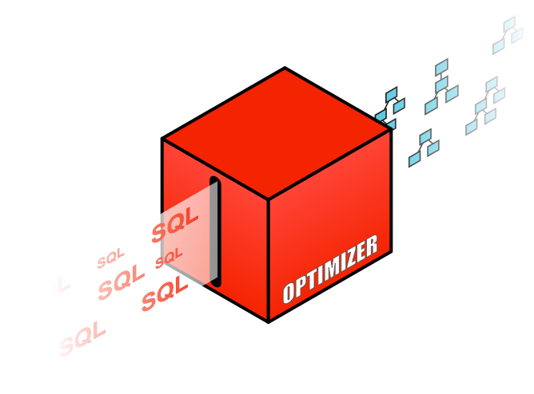
Explaining the Explain Plan: Interpreting Execution Plans for SQL Statements

Slide 2



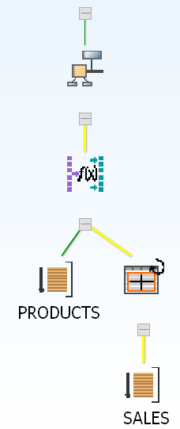
What Happens when a SQL statement is issued?
1
User
2
Oracle Database
Syntax Check
SQL Execution
Parsing
Semantic Check
4
Shared Pool check
Dictionary
Shared Pool
3
Query Transformation
Library Cache
Plan Generator
Cost Estimator
Shared SQL Area
…
Optimizer
C1
C2
Cn
Code Generator

Slide 3
Agenda
What is an execution plan
How to generate a plan
What is a good plan for the Optimizer
Understanding execution plans
Execution plan examples

Slide 4
What is an execution plan?
Execution plans show the detailed steps necessary to execute a SQL statement
These steps are expressed as a set of database operators that consumes and produces rows
The order of the operators and their implementation is decided by the optimizer using a combination of query transformations and physical optimization techniques
The display is commonly shown in a tabular format, but a plan is in fact tree-shaped

Slide 5
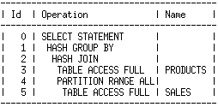
What is an execution plan?
Query:
SELECT prod_category, avg(amount_sold) FROM sales s, products p WHERE p.prod_id = s.prod_id GROUP BY prod_category; Tabular representation of plan
Tree-shaped representation of plan
GROUP BY
HASH JOIN
TABLE ACCESS PRODUCTS
TABLE ACCESS SALES

Slide 6
Agenda
What is an execution plan
How to generate a plan
What is a good plan for the Optimizer
Understanding execution plans
Execution plan examples

Slide 7
How to get an execution plan
Two methods for looking at the execution plan
EXPLAIN PLAN command
Displays an execution plan for a SQL statement without actually executing the statement
V$SQL_PLAN
A dictionary view introduced in Oracle 9i that shows the execution plan for a SQL statement that has been compiled into a cursor in the cursor cache
Either way use DBMS_XPLAN package to display plans
Under certain conditions the plan shown with EXPLAIN PLAN can be different from the plan shown using V$SQL_PLAN

Slide 8
How to get an execution plan example 1
EXPLAIN PLAN command & dbms_xplan.display function
SQL> EXPLAIN PLAN FOR SELECT prod_name, avg(amount_sold)
FROM sales s, products p
WHERE p.prod_id = s.prod_id
GROUP BY prod_name;
SQL> SELECT plan_table_output
FROM table(dbms_xplan.display('plan_table',null,'basic'));
Notes:
DBMS_XPLAN.DISPLAY takes three parameters
plan table name (default 'PLAN_TABLE'),
statement_id (default null),
format (default 'TYPICAL')

Slide 9
Explain Plan “lies”
Explain plan should hardly ever be used…
You have to be careful when using autotrace and related tools
Never use “explain=u/p” with tkprof
Avoid dbms_xplan.display, use display_cursor

Slide 10
Explain plan lies…
ops$tkyte%ORA11GR2> create table t
2 as
3 select 99 id, to_char(object_id) str_id, a.*
4 from all_objects a
5 where rownum <= 20000;
Table created.
ops$tkyte%ORA11GR2> update t
2 set id = 1
3 where rownum = 1;
1 row updated.
ops$tkyte%ORA11GR2> create index t_idx on t(id);
Index created.
ops$tkyte%ORA11GR2> create index t_idx2 on t(str_id);
Index created.

Slide 11
Explain plan lies…
ops$tkyte%ORA11GR2> begin
2 dbms_stats.gather_table_stats
3 ( user, 'T',
4 method_opt=>'for all indexed columns size 254',
5 estimate_percent => 100,
6 cascade=>TRUE );
7 end;
8 /
PL/SQL procedure successfully completed.

Slide 12
Explain plan lies…
Need a volunteer

Slide 13
Explain plan lies…
Need a volunteer
select count(*) from t where id = :n;
What cardinality would you estimate and why?

Slide 14
Explain plan lies…
ops$tkyte%ORA11GR2> variable n number
ops$tkyte%ORA11GR2> exec :n := 99;
PL/SQL procedure successfully completed.
ops$tkyte%ORA11GR2> set autotrace traceonly explain
ops$tkyte%ORA11GR2> select count(*) from t where id = :n;
-------------------------------------------------------------------------------
| Id | Operation | Name | Rows | Bytes | Cost (%CPU)| Time |
-------------------------------------------------------------------------------
| 0 | SELECT STATEMENT | | 1 | 3 | 12 (0)| 00:00:01 |
| 1 | SORT AGGREGATE | | 1 | 3 | | |
|* 2 | INDEX FAST FULL SCAN| T_IDX | 10000 | 30000 | 12 (0)| 00:00:01 |
-------------------------------------------------------------------------------
Predicate Information (identified by operation id):
---------------------------------------------------
2 - filter("ID"=TO_NUMBER(:N)) <<= a clue right here

Slide 15
Explain plan lies…
ops$tkyte%ORA11GR2> select count(*) from t where id = 1;
Execution Plan
----------------------------------------------------------
Plan hash value: 293504097
---------------------------------------------------------------------------
| Id | Operation | Name | Rows | Bytes | Cost (%CPU)| Time |
---------------------------------------------------------------------------
| 0 | SELECT STATEMENT | | 1 | 3 | 1 (0)| 00:00:01 |
| 1 | SORT AGGREGATE | | 1 | 3 | | |
|* 2 | INDEX RANGE SCAN| T_IDX | 1 | 3 | 1 (0)| 00:00:01 |
---------------------------------------------------------------------------
Predicate Information (identified by operation id):
---------------------------------------------------
2 - access("ID"=1)

Slide 16
Explain plan lies…
ops$tkyte%ORA11GR2> select count(*) from t where id = 99;
Execution Plan
----------------------------------------------------------
Plan hash value: 1058879072
-------------------------------------------------------------------------------
| Id | Operation | Name | Rows | Bytes | Cost (%CPU)| Time |
-------------------------------------------------------------------------------
| 0 | SELECT STATEMENT | | 1 | 3 | 12 (0)| 00:00:01 |
| 1 | SORT AGGREGATE | | 1 | 3 | | |
|* 2 | INDEX FAST FULL SCAN| T_IDX | 19999 | 59997 | 12 (0)| 00:00:01 |
-------------------------------------------------------------------------------
Predicate Information (identified by operation id):
---------------------------------------------------
2 - filter("ID"=99)

Slide 17
Explain plan lies…
ops$tkyte%ORA11GR2> set autotrace traceonly explain
ops$tkyte%ORA11GR2> select object_id from t where str_id = :n;
--------------------------------------------------------------------------------
| Id | Operation | Name | Rows | Bytes | Cost (%CPU)| Time
--------------------------------------------------------------------------------
| 0 | SELECT STATEMENT | | 1 | 19 | 2 (0)| 00:0
| 1 | TABLE ACCESS BY INDEX ROWID| T | 1 | 19 | 2 (0)| 00:0
|* 2 | INDEX RANGE SCAN | T_IDX2 | 1 | | 1 (0)| 00:0
--------------------------------------------------------------------------------
Predicate Information (identified by operation id):
---------------------------------------------------
2 - access("STR_ID"=:N) <<== interesting…

Slide 18
Explain plan lies…
ops$tkyte%ORA11GR2> select object_id from t where str_id = :n;
OBJECT_ID
----------
99
ops$tkyte%ORA11GR2> select * from table(dbms_xplan.display_cursor);
--------------------------------------------------------------------------
| Id | Operation | Name | Rows | Bytes | Cost (%CPU)| Time |
--------------------------------------------------------------------------
| 0 | SELECT STATEMENT | | | | 86 (100)| |
|* 1 | TABLE ACCESS FULL| T | 1 | 19 | 86 (0)| 00:00:02 |
--------------------------------------------------------------------------
Predicate Information (identified by operation id):
---------------------------------------------------
1 - filter(TO_NUMBER("STR_ID")=:N) <<= string has to convert..

Slide 19
Explain plan lies…
1 - filter(TO_NUMBER("STR_ID")=:N) <<= string has to convert..
STR_ID
------
0
00
000
0.00
+0
-0
1,000
1.000

Slide 20
How to get an execution plan example 2
Generate & display execution plan for last SQL stmts executed in a session
SQL>SELECT prod_category, avg(amount_sold) FROM sales s, products p WHERE p.prod_id = s.prod_id GROUP BY prod_category;
SQL> SELECT plan_table_output FROM table(dbms_xplan.display_cursor(null,null,'basic'));
Notes:
SQL ID (default null, null means the last SQL statement executed in this session),
child number (default 0),
format (default 'TYPICAL')

Slide 21
DBMS_XPLAN parameters
DBMS_XPLAN.DISPLAY takes 3 parameters
plan table name (default 'PLAN_TABLE'),
statement_id (default null),
format (default 'TYPICAL')
DBMS_XPLAN.DISPLAY_CURSOR takes 3 parameters
SQL_ID (default last statement executed in this session),
Child number (default 0),
format (default 'TYPICAL')
Format* is highly customizable - Basic ,Typical, All
Additional low level parameters show more detail
*More information on formatting on Optimizer blog

Slide 22
Agenda
What is an execution plan
How to generate a plan
What is a good plan for the Optimizer
Understanding execution plans
Execution plan examples

Slide 23
What’s a good plan for the Optimizer?
The Optimizer has two different goals
Serial execution: It’s all about cost
The cheaper, the better
Parallel execution: it’s all about performance
The faster, the better
Two fundamental questions:
What is cost?
What is performance?

Slide 24
What is cost?
A magical number the optimizer makes up?
Resources required to execute a SQL statement?
Estimate of how long it will take to execute a statement?
Actual Definition
Cost represents units of work or resources used
Optimizer uses CPU & IO as units of work
Estimate of amount of CPU & disk I/Os, used to perform an operation
Cost is an internal Oracle measurement

Slide 25
What is performance?
Getting as many queries completed as possible?
Getting fastest possible elapsed time using the fewest resources?
Getting the best concurrency rate?
Actual Definition
Performance is fastest possible response time for a query
Goal is to complete the query as quickly as possible
Optimizer does not focus on resources needed to execute the plan

Slide 26
Agenda
What is an execution plan
How to generate a plan
What is a good plan for the optimizer
Understanding execution plans
Cardinality
Access paths
Join methods
Join order
Partition pruning
Parallel execution
Execution plan examples

Slide 27
Cardinality
What is it?
Estimate of number rows that will be returned by each operation
How does the Optimizer Determine it?
Cardinality for a single column equality predicate = total num of rows num of distinct values
For example: A table has 100 rows, a column has 10 distinct values => cardinality=10 rows
More complicated predicates have more complicated cardinality calculation
Why should you care?
Influences everything! Access method, Join type, Join Order etc
Notes:
Density is 1/num_distinct for columns without a histogram
For columns with a histogram density is calculated differently

Slide 28
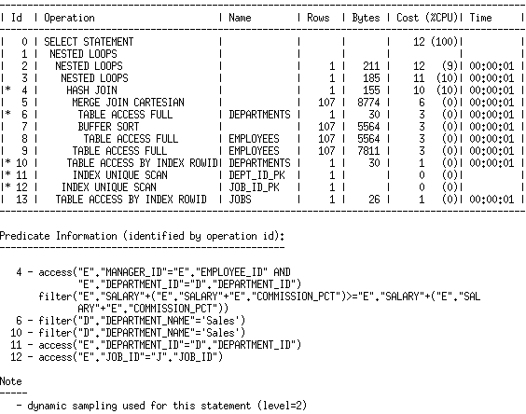
Identifying cardinality in an execution plan
Cardinality - estimated # of rows returned
Determine correct cardinality using a SELECT COUNT(*) from each table applying any WHERE Clause predicates belonging to that table

Slide 29
Checking cardinality estimates
SELECT /*+ gather_plan_statistics */ p.prod_name, SUM(s.quantity_sold)
FROM sales s, products p
WHERE s.prod_id =p.prod_id GROUP By p.prod_name ;
SELECT * FROM table (
DBMS_XPLAN.DISPLAY_CURSOR(FORMAT=>'ALLSTATS LAST'));

Slide 30
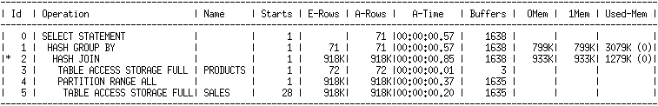
Checking cardinality estimates
SELECT * FROM table (
DBMS_XPLAN.DISPLAY_CURSOR(FORMAT=>'ALLSTATS LAST'));
Compare estimated number of rows returned for each operation to actual rows returned

Slide 31
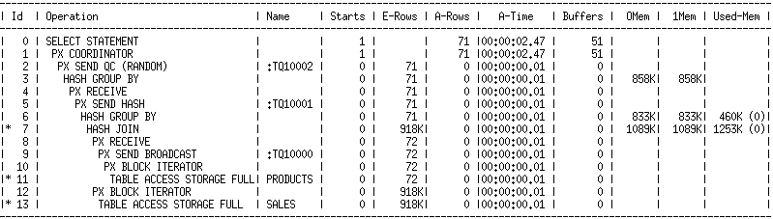
Checking cardinality estimates for PE
SELECT * FROM table (
DBMS_XPLAN.DISPLAY_CURSOR(FORMAT=>'ALLSTATS LAST'));
Note: a lot of the data is zero in the A-rows column because we only show last executed cursor which is the QC. Need to use ALLSTATS ALL to see info on all parallel server cursors

Slide 32
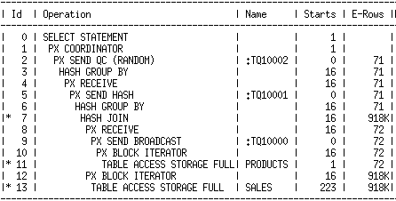
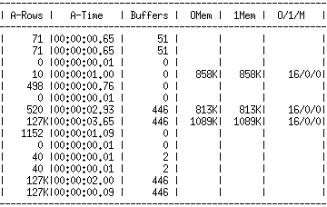
Checking cardinality estimates for PE
SELECT * FROM table (
DBMS_XPLAN.DISPLAY_CURSOR(FORMAT=>'ALLSTATS ALL'));

Slide 33
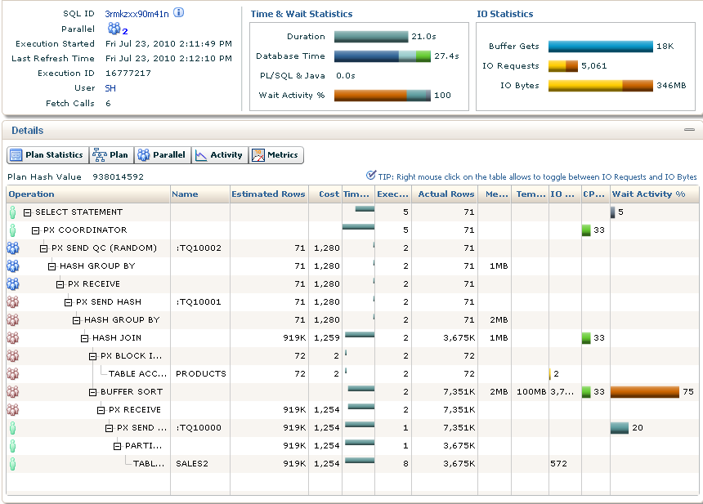
Check cardinality using SQL Monitor
SQL Monitor is the easiest way to compare the estimated number of rows returned for each operation in a parallel plan to actual rows returned

Slide 34
Solutions to incorrect cardinality estimates
Cause | Solution
Stale or missing statistics | DBMS_STATS
Data Skew | Create a histogram
Multiple single column predicates on a table | Create a column group using DBMS_STATS.CREATE_EXTENDED_STATS
Function wrapped column | Create statistics on the funct wrapped column using DBMS_STATS.CREATE_EXTENDED_STATS
Multiple columns used in a join | Create a column group on join columns using DBMS_STATS.CREATE_EXTENDED_STAT
Complicated expression containing columns from multiple tables | Use dynamic sampling level 4 or higher

Slide 35
Agenda
What is an execution plan
How to generate a plan
What is a good plan for the optimizer
Understanding execution plans
Cardinality
Access paths
Join methods
Join order
Partition pruning
Parallel execution
Execution plan examples

Slide 36
Access paths – Getting the data
Access Path | Explanation
Full table scan | Reads all rows from table & filters out those that do not meet the where clause predicates. Used when no index, DOP set etc
Table access by Rowid | Rowid specifies the datafile & data block containing the row and the location of the row in that block. Used if rowid supplied by index or in where clause
Index unique scan | Only one row will be returned. Used when stmt contains a UNIQUE or a PRIMARY KEY constraint that guarantees that only a single row is accessed
Index range scan | Accesses adjacent index entries returns ROWID values Used with equality on non-unique indexes or range predicate on unique index (<.>, between etc)
Index skip scan | Skips the leading edge of the index & uses the rest Advantageous if there are few distinct values in the leading column and many distinct values in the non-leading column
Full index scan | Processes all leaf blocks of an index, but only enough branch blocks to find 1st leaf block. Used when all necessary columns are in index & order by clause matches index struct or if sort merge join is done
Fast full index scan | Scans all blocks in index used to replace a FTS when all necessary columns are in the index. Using multi-block IO & can going parallel
Index joins | Hash join of several indexes that together contain all the table columns that are referenced in the query. Wont eliminate a sort operation
Bitmap indexes | uses a bitmap for key values and a mapping function that converts each bit position to a rowid. Can efficiently merge indexes that correspond to several conditions in a WHERE clause
Notes:
Full table reads all rows from a table and filters out those that do not
meet the where clause predicates. Does multi block IO. Influenced by
Value of init.ora parameter db_multi_block_read_count
Parallel degree
Lack of indexes
Hints
Typically selected if no indexes exist or the ones present cant be used
Or if the cost is the lowest due to DOP or DBMBRC
Rowid of a row specifies the datafile and data block containing the
row and the location of the row in that block. Oracle first obtains the
rowids either from the WHERE clause or through an index scan of one
or more of the table's indexes. Oracle then locates each selected row
in the table based on its rowid.
With an Index unique scan only one row will be returned. It will be used
When a statement contains a UNIQUE or a PRIMARY KEY constraint that
guarantees that only a single row is accessed.
An index range scan Oracle accesses adjacent index entries and then
uses the ROWID values in the index to retrieve the table rows. It can be
Bounded or unbounded. Data is returned in the ascending order of
index columns. It will be used when a stmt has an equality
predicate on non-unique index, or an incompletely specified unique
index, or range predicate on unique index. (=, <, >,LIKE if not on leading edge)
Uses index range scan descending when an order by descending
clause can be satisfied by an index.
Normally, in order for an index to be used, the columns defined on
the leading edge of the index would be referenced in the query however,
If all the other columns are referenced oracle will do an index skip scan to
Skip the leading edge of the index and use the rest of it. Advantageous if
there are few distinct values in the leading column of the composite index
and many distinct values in the non-leading key of the index.
A full scan does not read every block in the index structure, contrary to what
its name suggests. An index full scan processes all of the leaf blocks of an
index, but only enough of the branch blocks to find the first leaf block can
be used because all of the columns necessary are in the index
And it is cheaper than scanning the table and is used in any of the following situations:
An ORDER BY clause has all of the index columns in it
and the order is the same as in the index (can contain a subset of the columns in the index).
The query requires a sort merge join & all of the columns referenced in the query are in the index.
Order of the columns referenced in the query matches the order of the leading index columns.
A GROUP BY clause is present in the query, and the columns in the GROUP BY clause are present in the index.
A Fast full index scan is an alternative to a full table scan when the index c
ontains all the columns that are needed for the query, and at least one
column in the index key has the NOT NULL constraint. A fast full scan accesses
all of the data in the index itself, without accessing the table. It cannot be used
to eliminate a sort operation, because the data is not ordered by the index key.
It reads the entire index using multiblock reads, unlike a full index scan, and can be parallelized.
An index join is a hash join of several indexes that together contain all the table
columns that are referenced in the query. If an index join is used, then no table
access is needed, because all the relevant column values can be retrieved
from the indexes. An index join cannot be used to eliminate a sort operation.
A bitmap join uses a bitmap for key values and a mapping function that
converts each bit position to a rowid. Bitmaps can efficiently merge
indexes that correspond to several conditions in a WHERE clause,
using Boolean operations to resolve AND and OR conditions.

Slide 37
Identifying access paths in an execution plan
Look in Operation section to see how an object is being accessed
If the wrong access method is being used check cardinality, join order…

Slide 38
Common access path issues
Issue | Cause
Uses a table scan instead of index | DOP on table but not index, value of MBRC
Picks wrong index | Stale or missing statistics Cost of full index access is cheaper than index look up followed by table access Picks index that matches most # of column

Slide 39
Agenda
What is an execution plan
How to generate a plan
What is a good plan for the optimizer
Understanding execution plans
Cardinality
Access paths
Join methods
Join order
Partition pruning
Parallel execution
Execution plan examples

Slide 40
Join methods
Join Methods | Explanation
Nested Loops joins | For every row in the outer table, Oracle accesses all the rows in the inner table Useful when joining small subsets of data and there is an efficient way to access the second table (index look up)
Hash Joins | The smaller of two tables is scan and resulting rows are used to build a hash table on the join key in memory. The larger table is then scan, join column of the resulting rows are hashed and the values used to probing the hash table to find the matching rows. Useful for larger tables & if equality predicate
Sort Merge joins | Consists of two steps: Sort join operation: Both the inputs are sorted on the join key. Merge join operation: The sorted lists are merged together. Useful when the join condition between two tables is an inequality condition
Notes:
Nested loop joins are useful when small subsets of data are being joined
and if the join condition is an efficient way of accessing the second table (index look up),
That is the second table is dependent on the outer table (foreign key). For every row in
the outer table, Oracle accesses all the rows in the inner table. Consider it
Like two embedded for loops.
Hash joins are used for joining large data sets. The optimizer uses the smaller of two
tables or data sources to build a hash table on the join key in memory. It then
scans the larger table, probing the hash table to find the joined rows. Hash joins selected
If an equality predicate is present
Partition wise join <see next two slides>
Sort merge joins are useful when the join condition between two tables is an
inequality condition (but not a nonequality) like <, <=, >, or >=. Sort merge joins
perform better than nested loop joins for large data sets. The join consists of two steps:
Sort join operation: Both the inputs are sorted on the join key.
Merge join operation: The sorted lists are merged together.
A Cartesian join is used when one or more of the tables does not have any join
conditions to any other tables in the statement. The optimizer joins every row
from one data source with every row from the other data source,
creating the Cartesian product of the two sets. Only good if the tables involved are
Small. Can be a sign of problems with cardinality.
An outer join returns all rows that satisfy the join condition and also returns
some or all of those rows from the table without the (+) for which no rows from
the other satisfy the join condition. Take query: Select * from customers c, orders o
WHERE c.credit_limit > 1000 AND c.customer_id = o.customer_id(+)
The join preserves the customers rows, including those rows without a corresponding row in orders

Slide 41
Join types
Join Type | Explanation
Cartesian Joins | Joins every row from one data source with every row from the other data source, creating the Cartesian Product of the two sets. Only good if tables are very small. Only choice if there is no join condition specified in query
Outer Joins | Returns all rows that satisfy the join condition and also returns all of the rows from the table without the (+) for which no rows from the other table satisfy the join condition
Notes:
Nested loop joins are useful when small subsets of data are being joined
and if the join condition is an efficient way of accessing the second table (index look up),
That is the second table is dependent on the outer table (foreign key). For every row in
the outer table, Oracle accesses all the rows in the inner table. Consider it
Like two embedded for loops.
Hash joins are used for joining large data sets. The optimizer uses the smaller of two
tables or data sources to build a hash table on the join key in memory. It then
scans the larger table, probing the hash table to find the joined rows. Hash joins selected
If an equality predicate is present
Partition wise join <see next two slides>
Sort merge joins are useful when the join condition between two tables is an
inequality condition (but not a nonequality) like <, <=, >, or >=. Sort merge joins
perform better than nested loop joins for large data sets. The join consists of two steps:
Sort join operation: Both the inputs are sorted on the join key.
Merge join operation: The sorted lists are merged together.
A Cartesian join is used when one or more of the tables does not have any join
conditions to any other tables in the statement. The optimizer joins every row
from one data source with every row from the other data source,
creating the Cartesian product of the two sets. Only good if the tables involved are
Small. Can be a sign of problems with cardinality.
An outer join returns all rows that satisfy the join condition and also returns
some or all of those rows from the table without the (+) for which no rows from
the other satisfy the join condition. Take query: Select * from customers c, orders o
WHERE c.credit_limit > 1000 AND c.customer_id = o.customer_id(+)
The join preserves the customers rows, including those rows without a corresponding row in orders

Slide 42
Identifying join methods in an execution plan
Look in the Operation section to check the right join type is used
If wrong join type is used check stmt is written correctly & cardinality estimates

Slide 43
What causes wrong join method to be selected
Issue | Cause
Nested loop selected instead of hash join | Cardinality estimate on the left side is under estimated triggers Nested loop to be selected
Hash join selected instead of nested loop | In case of a hash join the Optimizer doesn’t taken into consideration the benefit of caching. Rows on the left come in a clustered fashion or (ordered) so the probe in
Cartesian Joins | Cardinality underestimation
Notes:
Nested loop joins are useful when small subsets of data are being joined
and if the join condition is an efficient way of accessing the second table (index look up),
That is the second table is dependent on the outer table (foreign key). For every row in
the outer table, Oracle accesses all the rows in the inner table. Consider it
Like two embedded for loops.
Hash joins are used for joining large data sets. The optimizer uses the smaller of two
tables or data sources to build a hash table on the join key in memory. It then
scans the larger table, probing the hash table to find the joined rows. Hash joins selected
If an equality predicate is present
Partition wise join <see next two slides>
Sort merge joins are useful when the join condition between two tables is an
inequality condition (but not a nonequality) like <, <=, >, or >=. Sort merge joins
perform better than nested loop joins for large data sets. The join consists of two steps:
Sort join operation: Both the inputs are sorted on the join key.
Merge join operation: The sorted lists are merged together.
A Cartesian join is used when one or more of the tables does not have any join
conditions to any other tables in the statement. The optimizer joins every row
from one data source with every row from the other data source,
creating the Cartesian product of the two sets. Only good if the tables involved are
Small. Can be a sign of problems with cardinality.
An outer join returns all rows that satisfy the join condition and also returns
some or all of those rows from the table without the (+) for which no rows from
the other satisfy the join condition. Take query: Select * from customers c, orders o
WHERE c.credit_limit > 1000 AND c.customer_id = o.customer_id(+)
The join preserves the customers rows, including those rows without a corresponding row in orders

Slide 44
Agenda
What is an execution plan
How to generate a plan
What is a good plan for the optimizer
Understanding execution plans
Cardinality
Access paths
Join methods
Join order
Partition pruning
Parallel execution
Execution plan examples

Slide 45
Join order
The order in which the tables are join in a multi table statement
Ideally start with the table that will eliminate the most rows
Strongly affected by the access paths available
Some basic rules
Joins guaranteed to produce at most one row always go first
Joins between two row sources that have only one row each
When outer joins are used the table with the outer join operator must come after the other table in the predicate
If view merging is not possible all tables in the view will be joined before joining to the tables outside the view

Slide 46
Identifying join order in an execution plan
1
2
3
4
5
Want to start with the table that reduce the result set the most
If the join order is not correct, check the statistics, cardinality & access methods

Slide 47
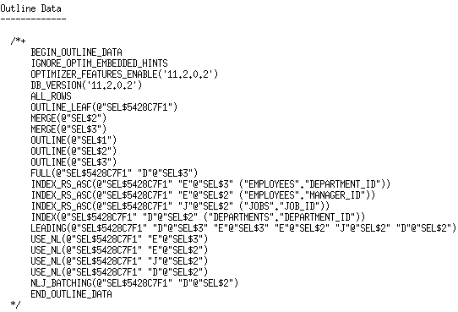
Finding the join order for complex SQL
It can be hard to determine Join Order for Complex SQL statements but it is easily visible in the outline data of plan
SELECT * FROM table(dbms_xplan.display_cursor(FORMAT=>’TYPICAL +outline’);
The leading hint tells you the join order

Slide 48
What causes the wrong join order
Causes
Incorrect single table cardinality estimates
Incorrect join cardinality estimates
Notes:
F,1 = D.1
F.2 = D.2
Cartien product between D1 and D2 then join to F only if the single table cardinalities

Slide 49
Agenda
What is an execution plan
How to generate a plan
What is a good plan for the optimizer
Understanding execution plans
Cardinality
Access paths
Join methods
Join order
Partition pruning
Parallel execution
Execution plan examples

Slide 50

Partition pruning
Q: What was the total sales for the weekend of May 20 ⁻ 22 2012?
Sales Table
May 18th 2012
May 19th 2012
Select sum(sales_amount)
From SALES
Where sales_date between
to_date(‘05/20/2012’,’MM/DD/YYYY’)
And
to_date(‘05/22/2012’,’MM/DD/YYYY’);
May 20th 2012
May 21st 2012
May 22nd 2012
Only the 3 relevant partitions are accessed
May 23rd 2012
May 24th 2012

Slide 51
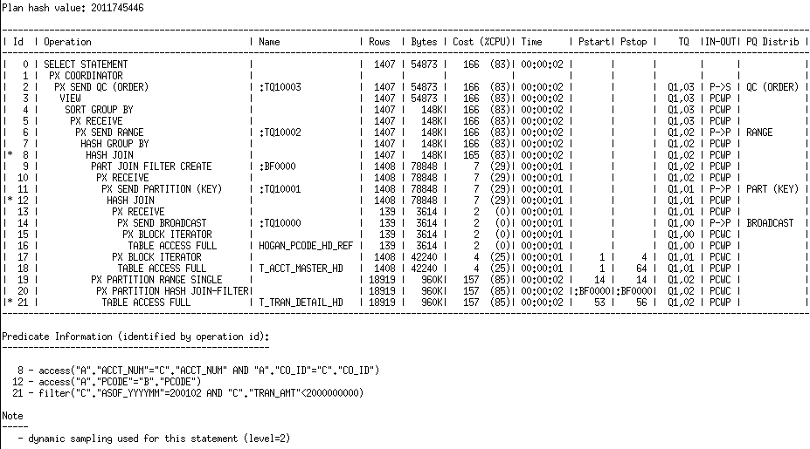
Identifying partition pruning in a plan
Pstart and Pstop list the partition touched by the query
If you see the word ‘KEY’ listed it means the partitions touched will be decided at Run Time

Slide 52
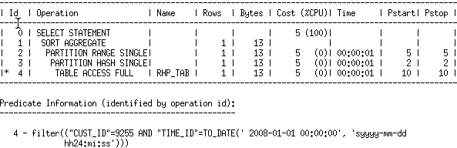
Partition pruning
Numbering of partitions
SELECT COUNT(*)FROM RHP_TAB
WHERE CUST_ID = 9255 AND TIME_ID = ‘2008-01-01’;
Why so many numbers in the Pstart / Pstop columns?

Slide 53
Partition pruning
Numbering of partitions
RHP_TAB
Partition 1
1
Sub-part 1
The RHP_TAB table is ranged partitioned by times and sub-partitioned on cust_id
An execution plan show partition numbers for static pruning
Each partition is numbered 1 to N
Within each partition subpartitions are numbered 1 to M
Each physical object in the table is given an overall partition number from 1 to N*M
2
Sub-part 2
:
Partition 5
9
Sub-part 1
10
Sub-part 2
:
Partition 10
19
Sub-part 1
20
Sub-part 2

Slide 54
Partition pruning
Numbering of partitions
SELECT COUNT(*)FROM RHP_TAB
WHERE CUST_ID = 9255 AND TIME_ID = ‘2008-01-01’;
Why so many numbers in the Pstart / Pstop columns?
Range partition #
Sub- partition #
Overall partition #

Slide 55
Partition pruning
Dynamic partition pruning
Advanced Pruning mechanism for complex queries
Recursive statement evaluates the relevant partitions at runtime
Look for the word ‘KEY’ in PSTART/PSTOP columns
Sales Table
Jan 2012
SELECT sum(amount_sold) FROM sales s, times t WHERE t.time_id = s.time_id AND t.calendar_month_desc IN
(‘MAR-12’,‘APR-12’,‘MAY-12’);
Times Table
Feb 2012
Mar 2012
Apr 2012
May 2012
June 2012
Jul 2012

Slide 56
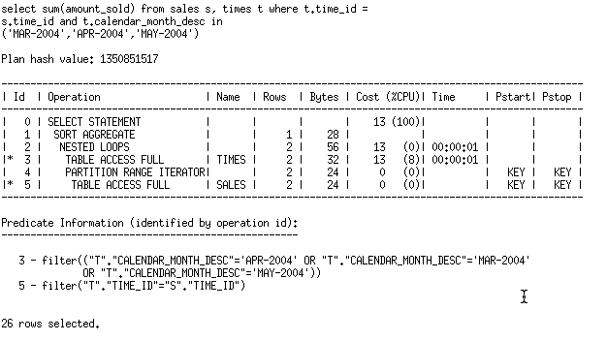
Partition pruning
Dynamic partition pruning
Sample explain plan output
Sample plan

Slide 57
Identifying partition pruning in a plan
Pstart and Pstop list the partition touched by the query
What does :BF0000 mean?

Slide 58
Agenda
What is an execution plan
How to generate a plan
What is a good plan for the optimizer
Understanding execution plans
Cardinality
Access paths
Join methods
Join order
Partition pruning
Parallel execution
Execution plan examples

Slide 59



How parallel execution works
User connects to the database
Background process is spawned
When user issues a parallel SQL statement the background process becomes the Query Coordinator
User
QC gets parallel servers from global pool and distributes the work to them
Parallel servers communicate among themselves & the QC using messages that are passed via memory buffers in the shared pool
Parallel servers - individual sessions that perform work in parallel Allocated from a pool of globally available parallel server processes & assigned to a given operation
Notes:
When a SQL statement is executed it will be hard parsed and a serial plan will be developed
The expected elapse time of that plan will be examined. If the expected Elapse time is
Less than PARALLEL_MIN_TIME_THRESHOLD then the query will execute serially.
If the expected Elapse time is greater than PARALLEL_MIN_TIME_THRESHOLD then the plan
Will be re-evaluated to run in parallel and the optimizer will determine the ideal DOP. The
Optimizer automatically determines the DOP based on the resource required for all scan operations
(full table scan, index fast full scan and so on)
However, the optimizer will cap the actual DOP for a statement with the default DOP
(paralllel_threads_per_cpu X CPU_COUNT X INSTANCE_COUNT), to ensure parallel
Processes do not flood the system.

Slide 60
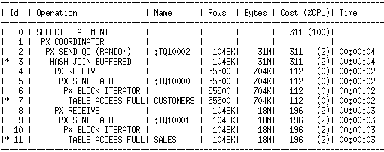

Identifying parallel execution in the plan
SELECT c.cust_last_name, s.time_id, s.amount_sold
FROM sales s, customers c
WHERE s.cust_id = c.cust_id;
Query Coordinator
Parallel Servers do majority of the work

Slide 61
Identifying granules of parallelism in the plan
Data is divided into granules either
block range
Partition
Each parallel server is allocated one or more granules
The granule method is specified on line above the scan operation in the plan

Slide 62
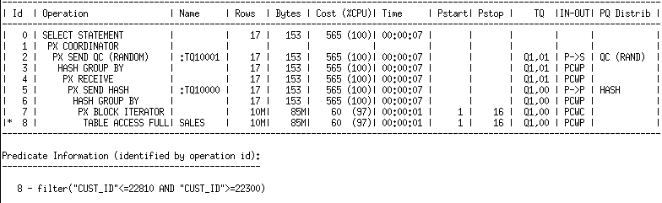
Identifying granules of parallelism in the plan
Parallel execution granules that are data blocks

Slide 63
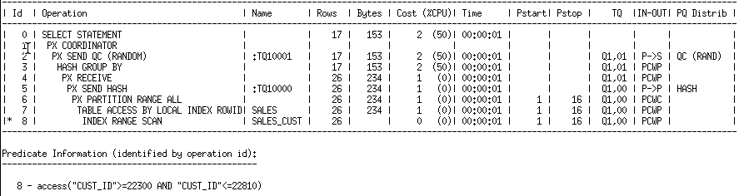
Identifying granules of parallelism in the plan
Parallel execution granules that are partitions

Slide 64
Access paths and how they are parallelized
Access Paths | Parallelization method
Full table scan | Block Iterator
Table accessed by Rowid | Partition
Index unique scan | Partition
Index range scan (descending) | Partition
Index skip scan | Partition
Full index scan | Partition
Fast full index scan | Block Iterator
Bitmap indexes (in Star Transformation) | Block Iterator

Slide 65
How parallel execution works
SELECT ………..
FROM sales s, customers c
WHERE s.cust_id = c.cust_id;
Query coordinator
P1
P2
P3
P4
Consumers
Sales Table
Customers Table
Hash join always begins with a scan of the smaller table. In this case that’s is the customer table. The 4 producers scan the customer table and send the resulting rows to the consumers
P5
P6
P7
P8
Producers
Notes:
You can better understand how two sets of parallel processes work together through these next few slides.

Slide 66
How parallel execution works
SELECT ………..
FROM sales s, customers c
WHERE s.cust_id = c.cust_id;
Query coordinator
P1
P2
P3
P4
Consumers
Sales Table
Customers Table
P5
Once the 4 producers finish scanning the customer table, they start to scan the Sales table and send the resulting rows to the consumers
P6
P7
P8
Producers
Notes:
You can better understand how two sets of parallel processes work together through these next few slides.

Slide 67
How Parallel Execution works
Once the consumers receive the rows from the sales table they begin to do the join. Once completed they return the results to the QC
SELECT ………..
FROM sales s, customers c
WHERE s.cust_id = c.cust_id;
Query coordinator
P1
P2
P3
P4
Consumers
Sales Table
Customers Table
P5
P6
P7
P8
Producers
Notes:
You can better understand how two sets of parallel processes work together through these next few slides.

Slide 68
Identifying parallel execution in a plan
IN-OUT column shows which step is run in parallel and if it is a single parallel server set or not
If lines begins with the letter S you are running Serial check DOP for each table & index used

Slide 69
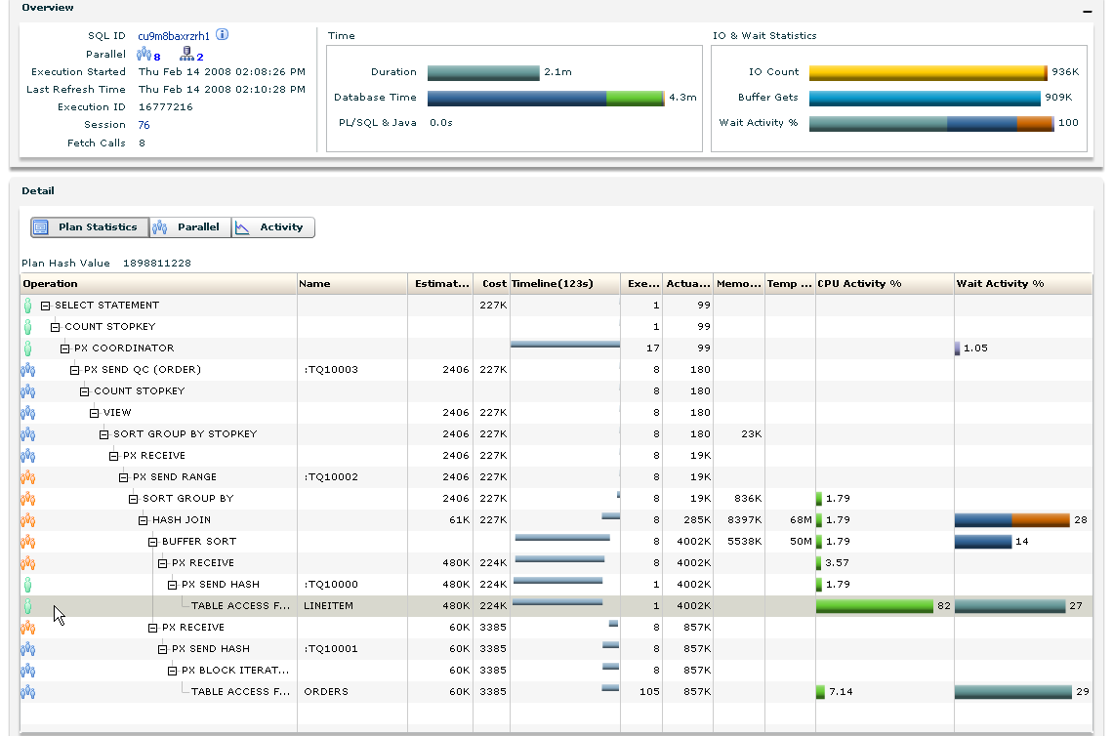
Identifying parallel execution in a plan

Slide 70
Parallel distribution
Necessary when producers & consumers sets are used
Producers must pass or distribute their data into consumers
Operator into which the rows flow decides the distribution
Distribution can be local or across other nodes in RAC
Five common types of redistribution

Slide 71
Parallel distribution
HASH
Hash function applied to value of the join column
Distribute to the consumer working on the corresponding hash partition
Round Robin
Randomly but evenly distributes the data among the consumers
Broadcast
The size of one of the result sets is small
Sends a copy of the data to all consumers

Slide 72
Parallel distribution
Range
Typically used for parallel sort operations
Individual parallel servers work on data ranges
QC doesn’t sort just present the parallel server results in the correct order
Partitioning Key Distribution – PART (KEY)
Assumes that the target table is partitioned
Partitions of the target tables are mapped to the parallel servers
Producers will map each scanned row to a consumer based on partitioning column

Slide 73
Indentifying parallel distribution in the plan
Shows how the PQ servers distribute rows between each other

Slide 74
More Information
Accompanying white paper series
Explain the Explain Plan
Optimizer Blog
http://blogs.oracle.com/optimizer
Oracle.com
http://www.oracle.com/technetwork/database/focus-areas/bi-datawarehousing/dbbi-tech-info-optmztn-092214.html

Slide 75

Lunch

